Slide 1

The journey to /W4 /WX: How hard could it be?
Keith Stockdale,
Senior Software Engineer

Slide 2

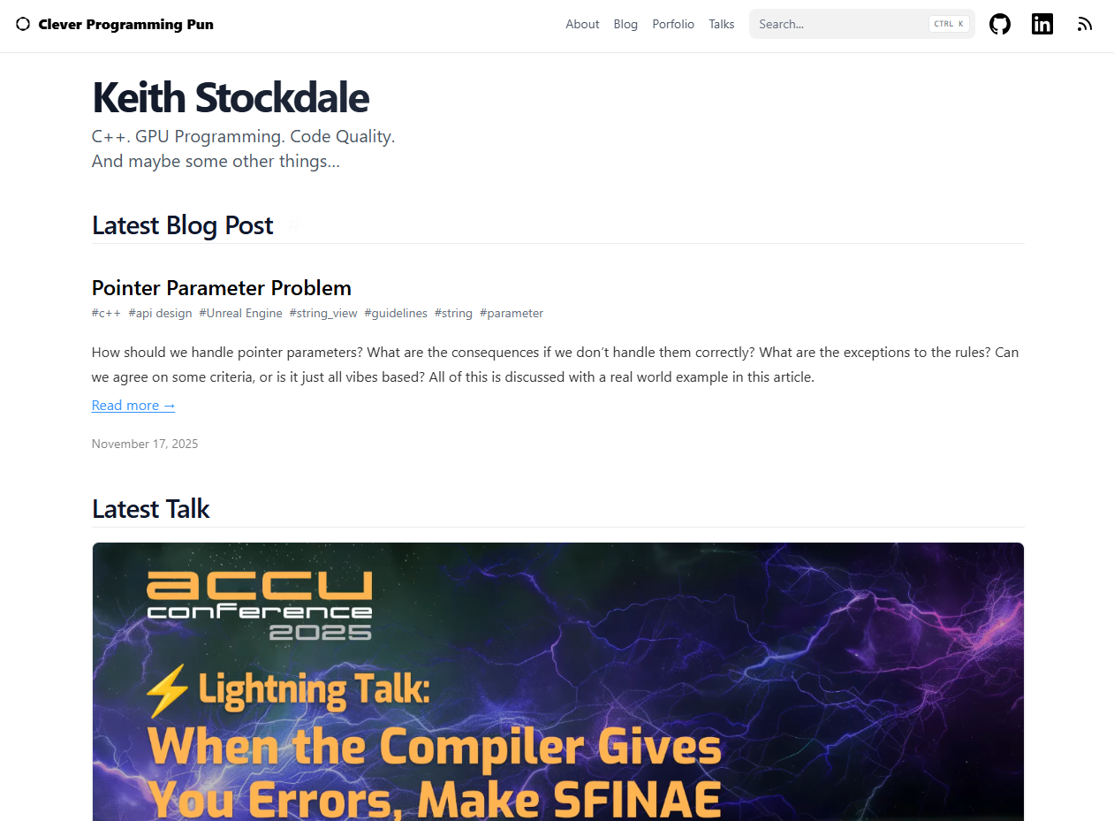

About me!
Senior Software Engineer at Rare Ltd
Started as an intern in 2015
Work on the rendering and engine teams

Slide 3








About Rare

Slide 4


Upgrading to C++20

Slide 5



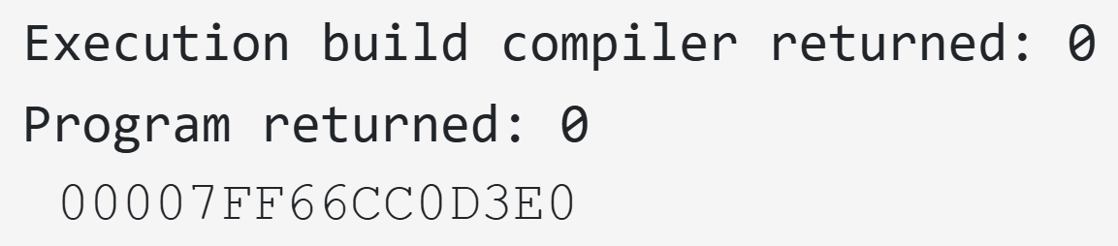
What did we achieve?
 | /std:c++17 (mins:secs) | /std:c++17 /permissive- (mins:secs) | /std:c++20 (mins:secs)
Mean Rebuild Time | 12:58.7 | 12:46.4 | 12:47.7
#include <iostream>
int main()
{
std::cout << L"Hello BeCPP";
}
MyStruct MyObj
{
  .Name{ TEXT("Foo") },
  .Position{ 2.0, 3.14, 42.0 }
};

Slide 6
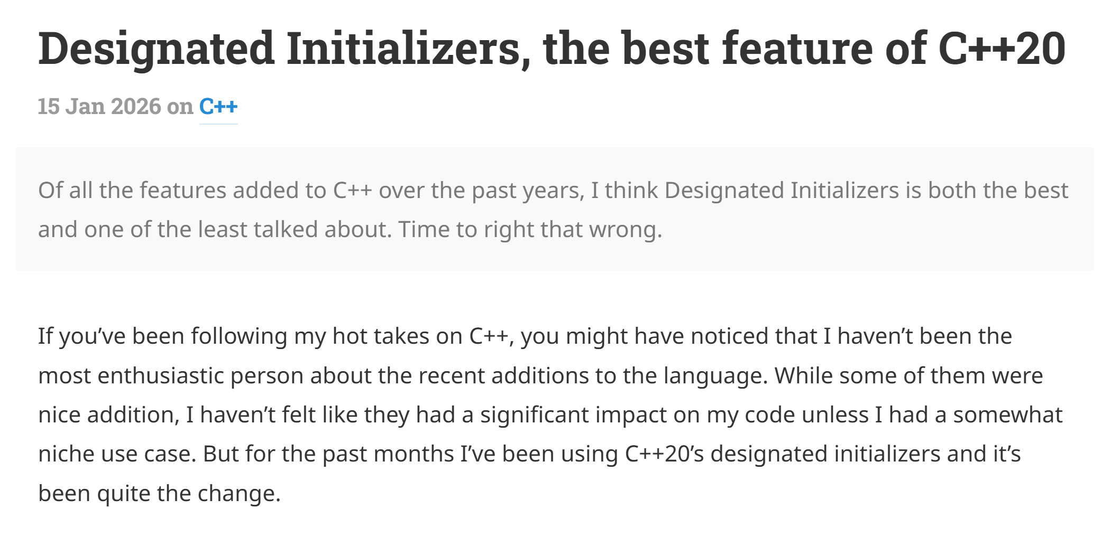

Designated Initializers, the best feature of C++20

Slide 7

So why /W4 /WX?

Slide 8
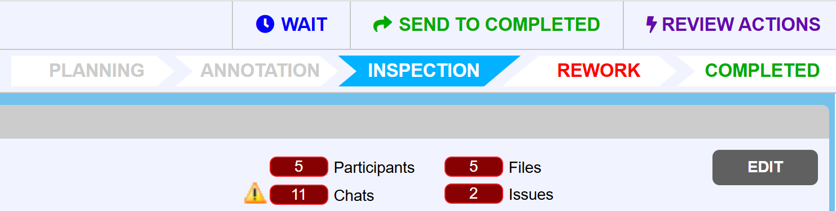

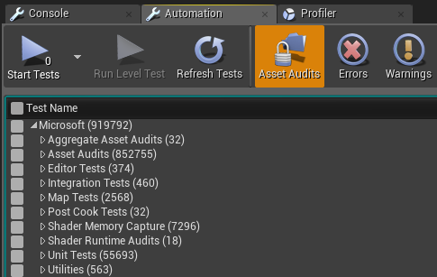
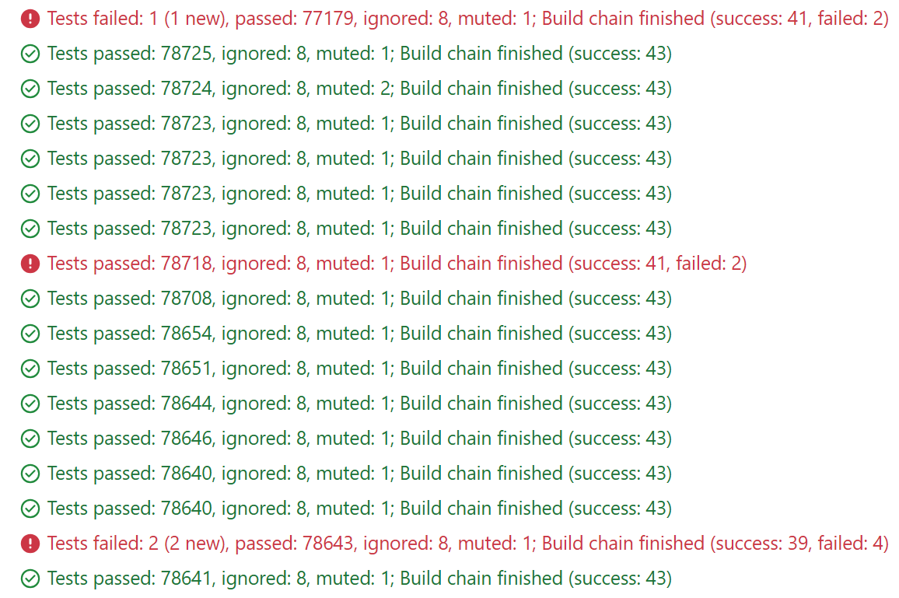
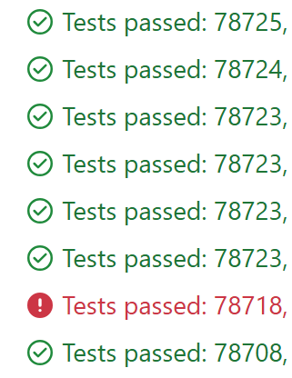
The journey of code at Rare

Slide 9
The journey of code at Rare

Slide 10

The journey of code at Rare

Slide 11
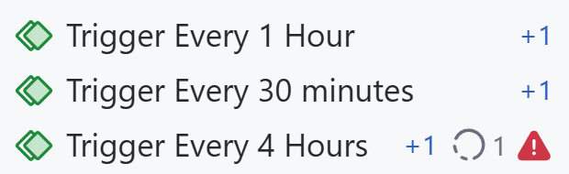
The journey of code at Rare

Slide 12
The journey of code at Rare
Cheap
Issue Cost
Expensive

Slide 13

How do warnings help?
“Warnings are diagnostic messages that report constructions that are not inherently erroneous but that are risky or suggest there may have been an error.” – GCC docs

Slide 14

So where does /W4 come in?
“Use every available and reasonable set of warning options…”
“…/W4 = All reasonable warnings” – Jason Turner

Slide 15
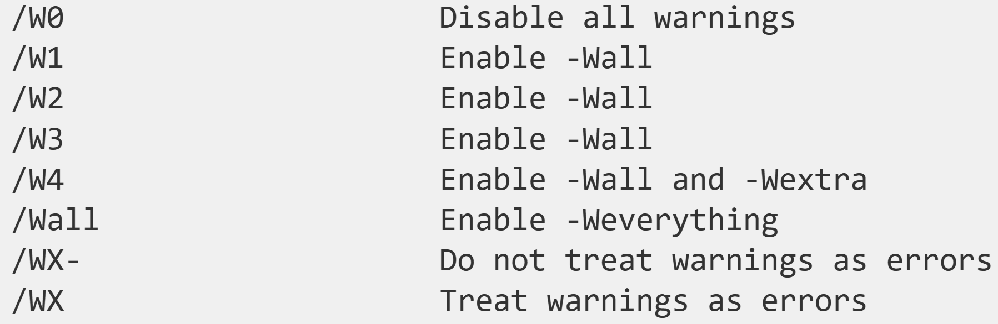
For the GCC/Clang users

Slide 16
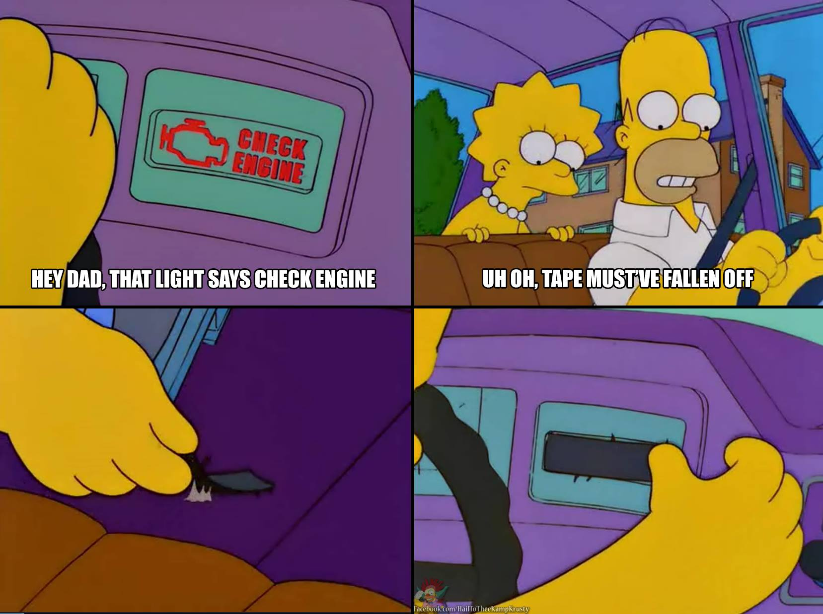
And why /WX?

Slide 17
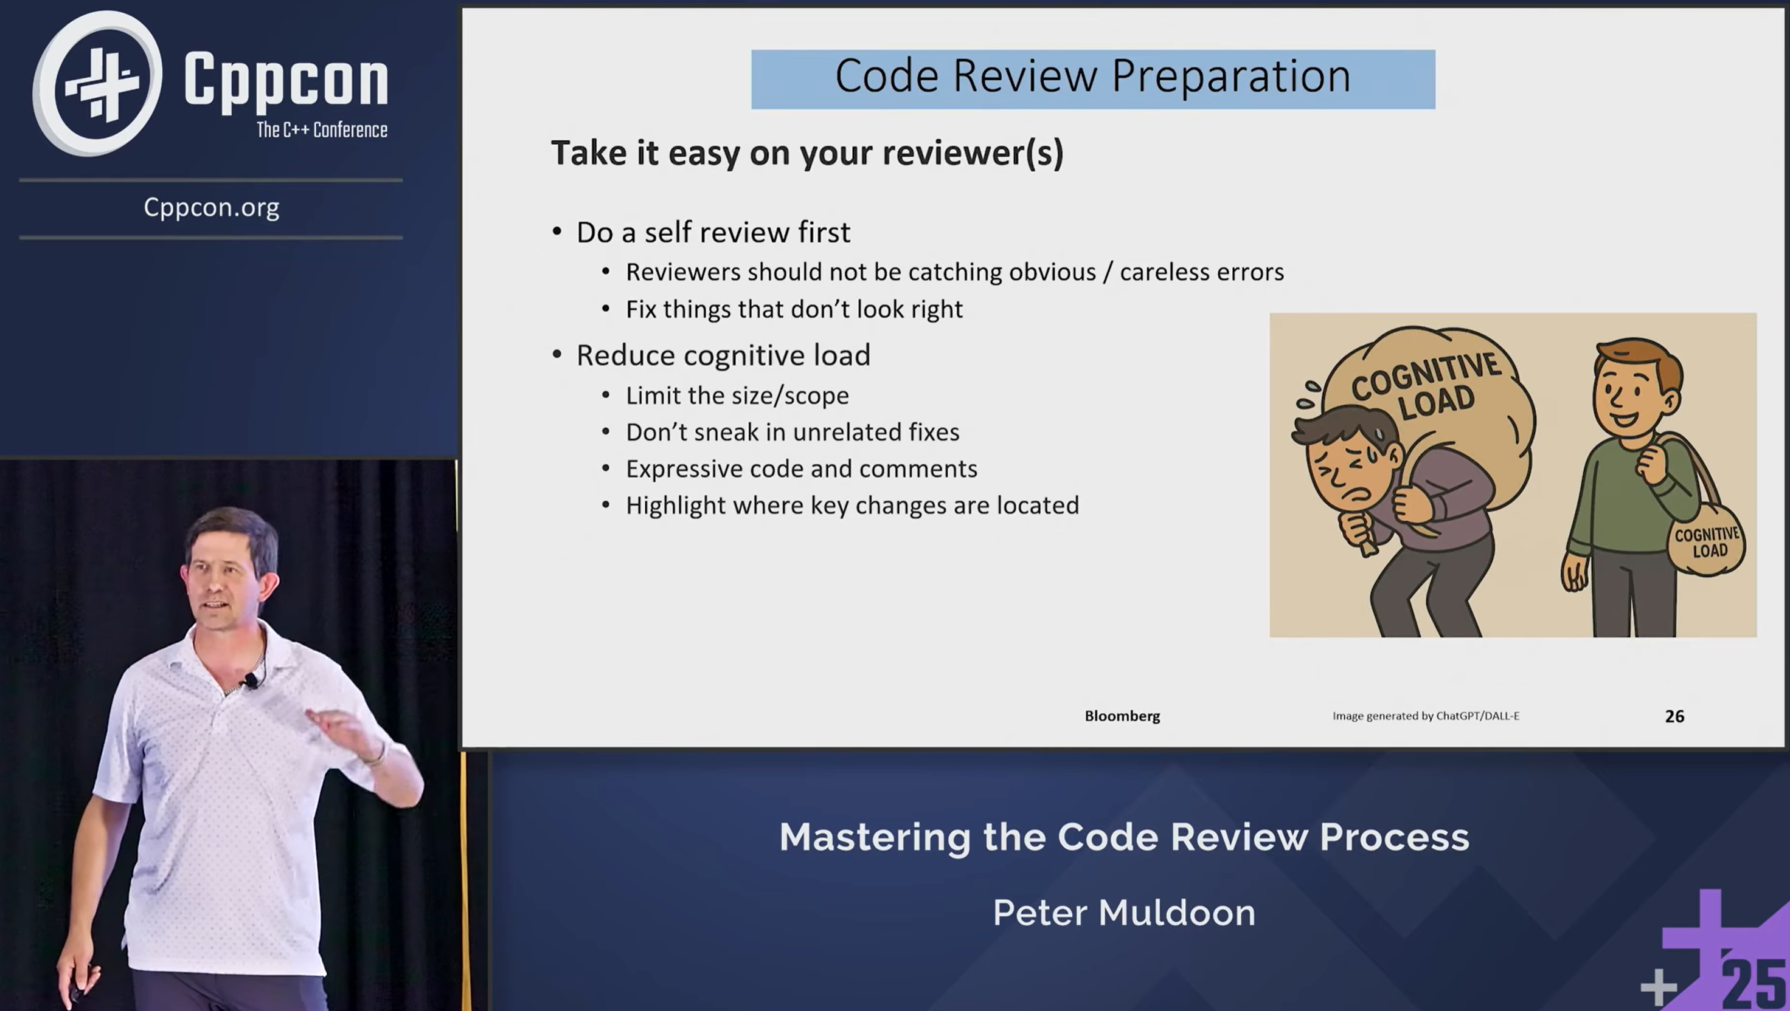

/W4 /WX shifts the load on to the compiler

Slide 18
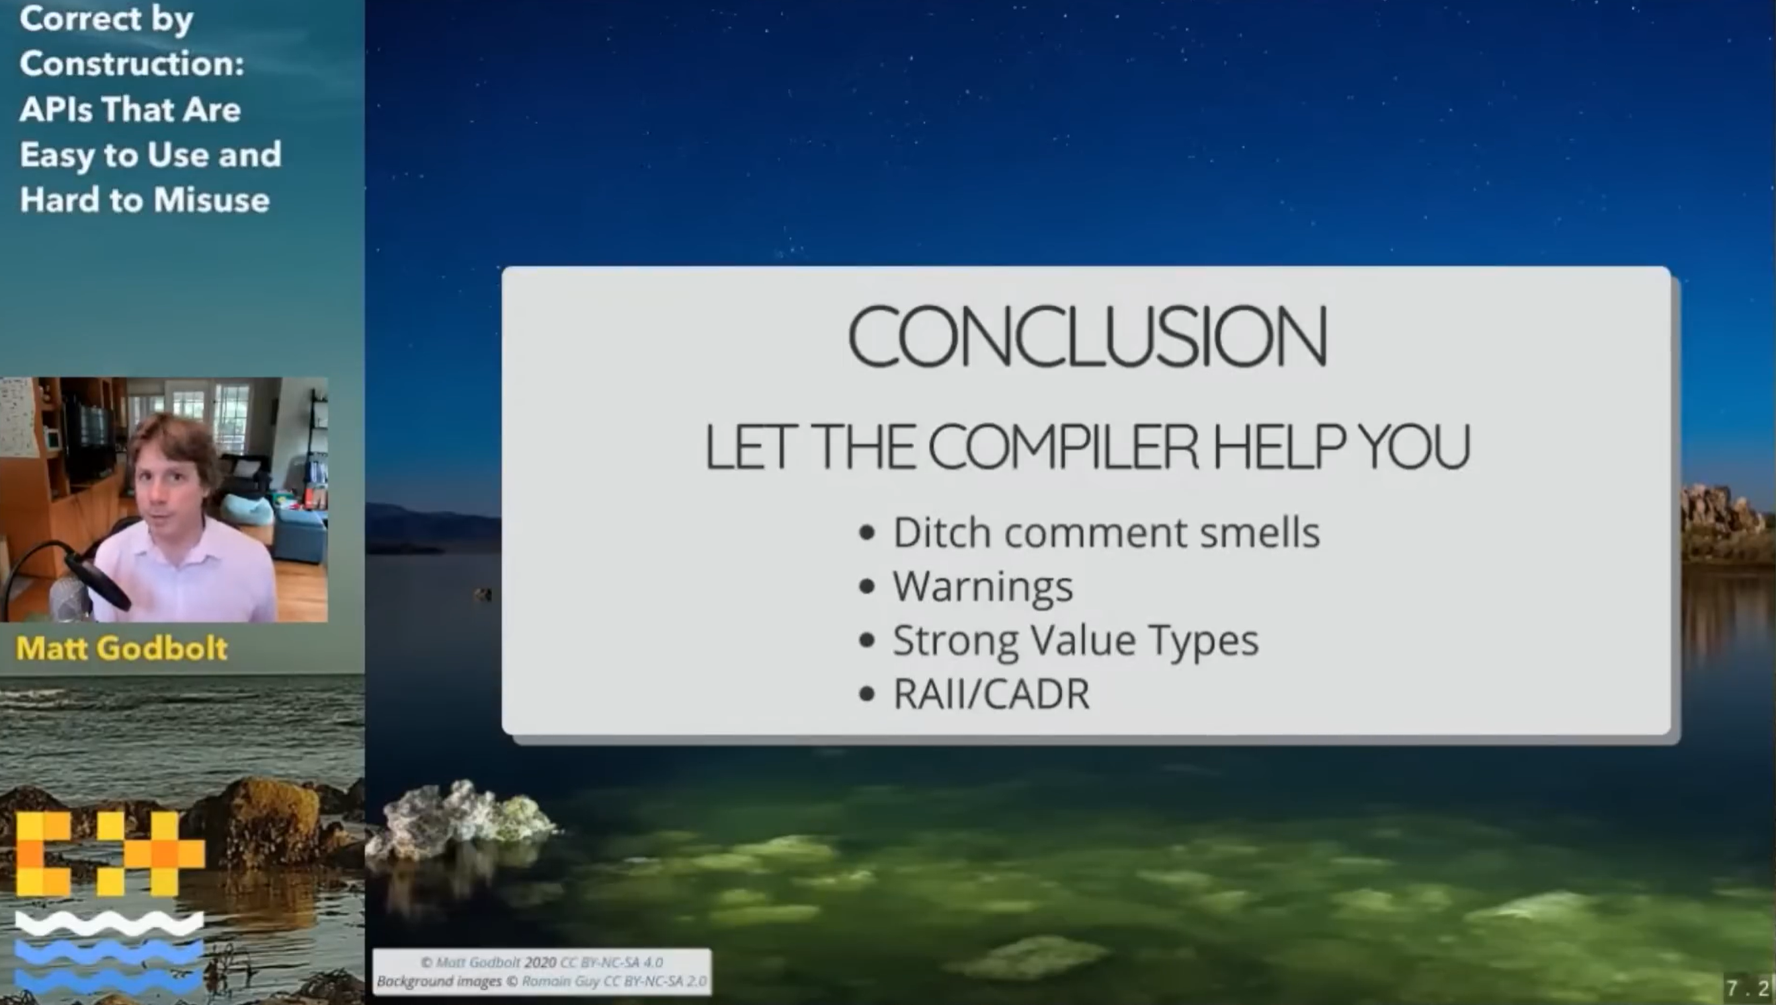

High warning levels are good practice…

Slide 19

… but can be tricky
“Start with very strict warning settings from the beginning. Trying to raise the warning level after the project is underway can be painful” – Jason Turner

Slide 20
Sea of Thieves’ code base
 | Sea of Thieves project | Engine
Number of C++ files
Lines of Code
29,936
19,580
3,251,088
3,475,065

Slide 21
Code base growth in a year
 | Sea of Thieves project | Engine
Number of C++ files
Lines of Code
1,667
161
273,940
26,037

Slide 22
What was our warning level?
// Set warning level.
if (Target.WindowsPlatform.Compiler != WindowsCompiler.Intel)
{
// Restrictive during regular compilation.
Arguments.Add("/W4");
}
else
{
// If we had /W4 with clang or Intel on windows we would be flooded with warnings. This will be fixed incrementally.
Arguments.Add("/W0");
}

Slide 23

We are already at /W4!

Slide 24
Plan of action

Slide 25

Step 1: Fix all the warnings in the editor

Slide 26
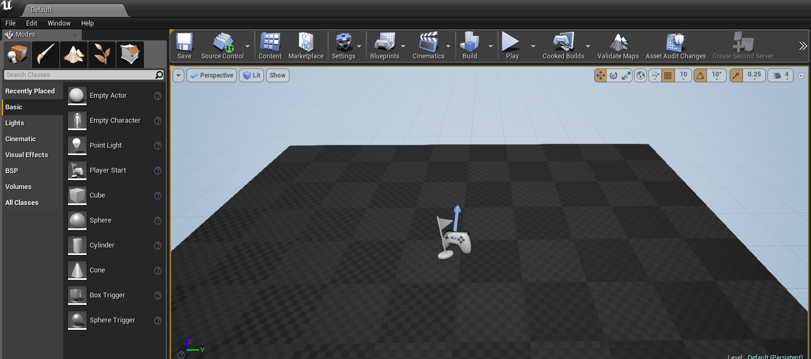
Unreal Engine Editor

Slide 27
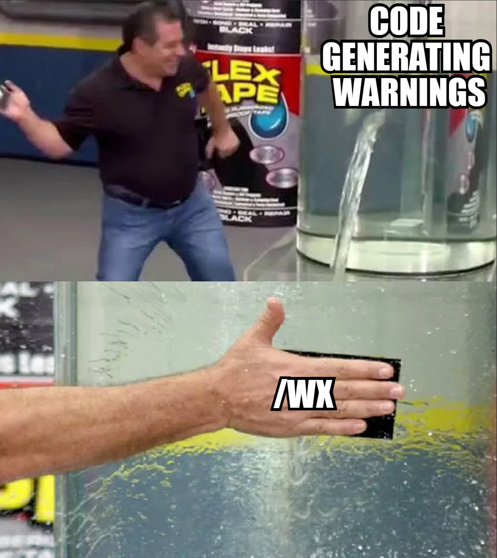
Step 2: Enable /WX for the editor

Slide 28
Step 3: Repeat for Server and Client

Slide 29


Slide 30
Code Review #1
class FDelegateHandle
{
public:
  explicit FDelegateHandle(EGenerateNewHandleType)
  : ID(GenerateNewID())
  {
  }
  uint32 GetID() const
  {
  return ID;
  }
private:
};

Slide 31
Code Review #1
class FDelegateHandle
{
public:
  explicit FDelegateHandle(EGenerateNewHandleType)
  : ID(GenerateNewID())
  {
  }
  uint32 GetID() const
  {
  return ID;
  }
private:
uint64 ID;
};

Slide 32
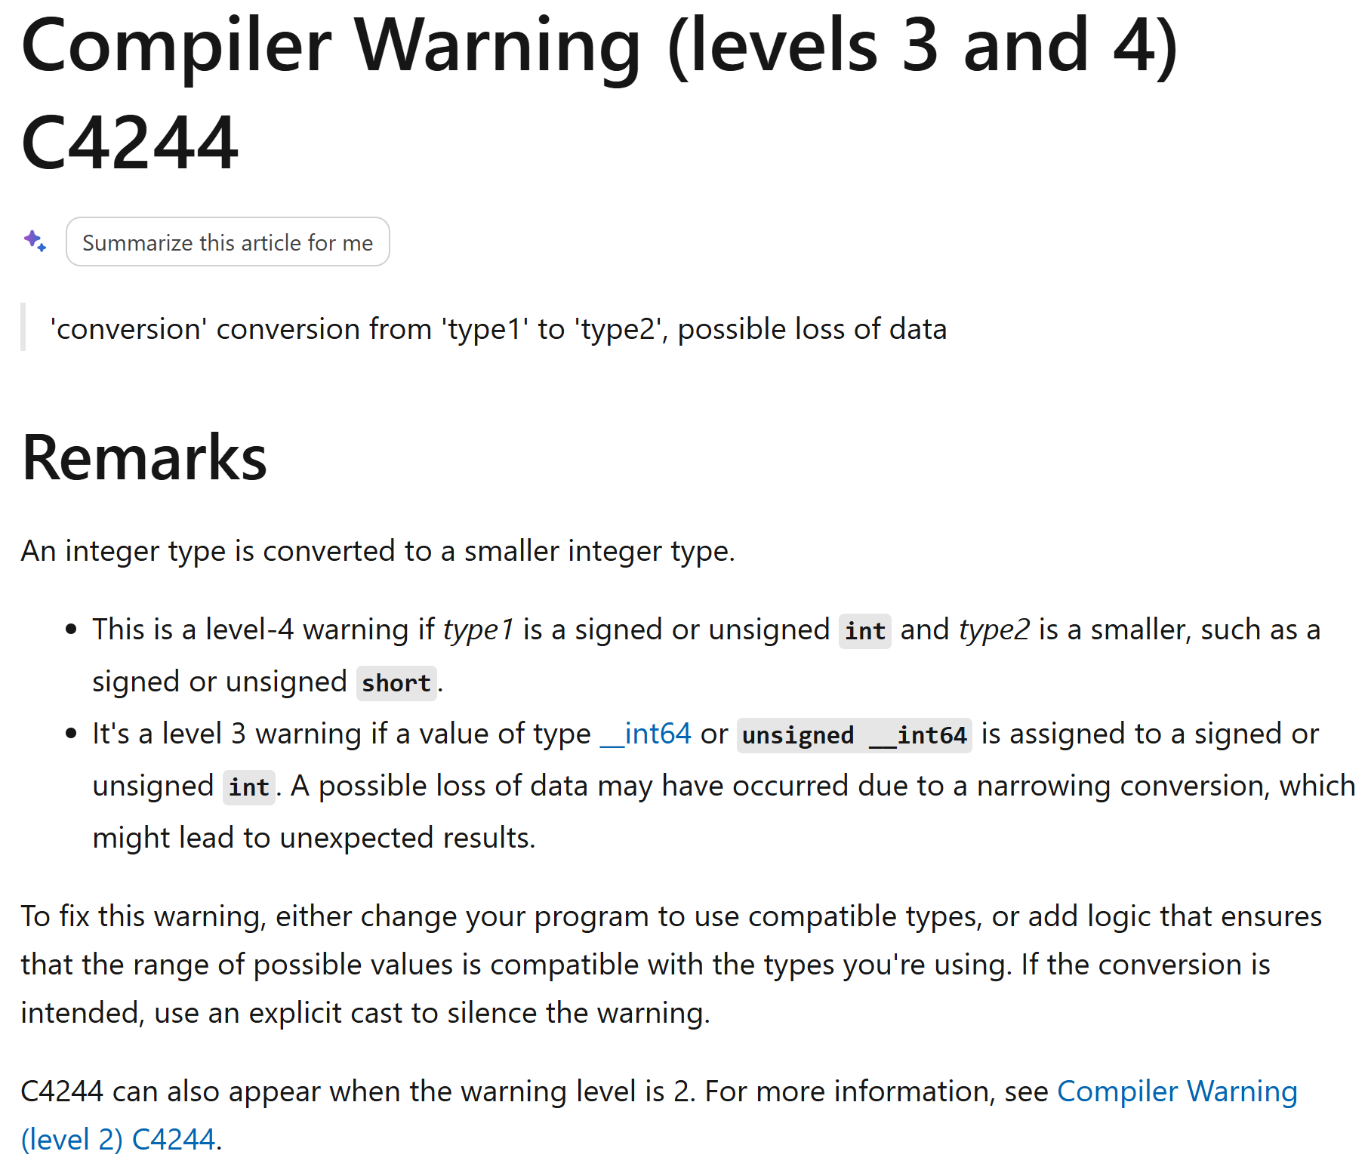

C4244 / -Wconversion
Notes:
https://godbolt.org/z/v63EcGPKc

Slide 33
Code Review #1
class FDelegateHandle
{
public:
  explicit FDelegateHandle(EGenerateNewHandleType)
  : ID(GenerateNewID())
  {
  }
  uint32 GetID() const
  {
  return ID;
  }
private:
uint64 ID;
};

Slide 34
Code Review #1 – Potential “fix”
class FDelegateHandle
{
public:
  explicit FDelegateHandle(EGenerateNewHandleType)
  : ID(GenerateNewID())
  {
  }
  uint32 GetID() const
  {
  return static_cast<uint32>(ID);
  }
private:
uint64 ID;
};

Slide 35
Code Review #1 – Potential fix
class FDelegateHandle
{
public:
  explicit FDelegateHandle(EGenerateNewHandleType)
  : ID(GenerateNewID())
  {
  }
  uint32 GetID() const
  {
  return ID;
  }
private:
uint32 ID;
};

Slide 36
Code Review #1 – Actual fix
class FDelegateHandle
{
public:
  explicit FDelegateHandle(EGenerateNewHandleType)
  : ID(GenerateNewID())
  {
  }
  uint64 GetID() const
  {
  return ID;
  }
private:
uint64 ID;
};

Slide 37
Code Review #2
enum MyEnum;
struct A
{
MyEnum mem;
};
enum MyEnum
{
One,
Two
};
int main()
{
return sizeof(A);
}

Slide 38
Code Review #2
enum MyEnum;
struct A
{
MyEnum mem;
};
enum MyEnum : char
{
One,
Two
};
int main()
{
return sizeof(A);
}

Slide 39
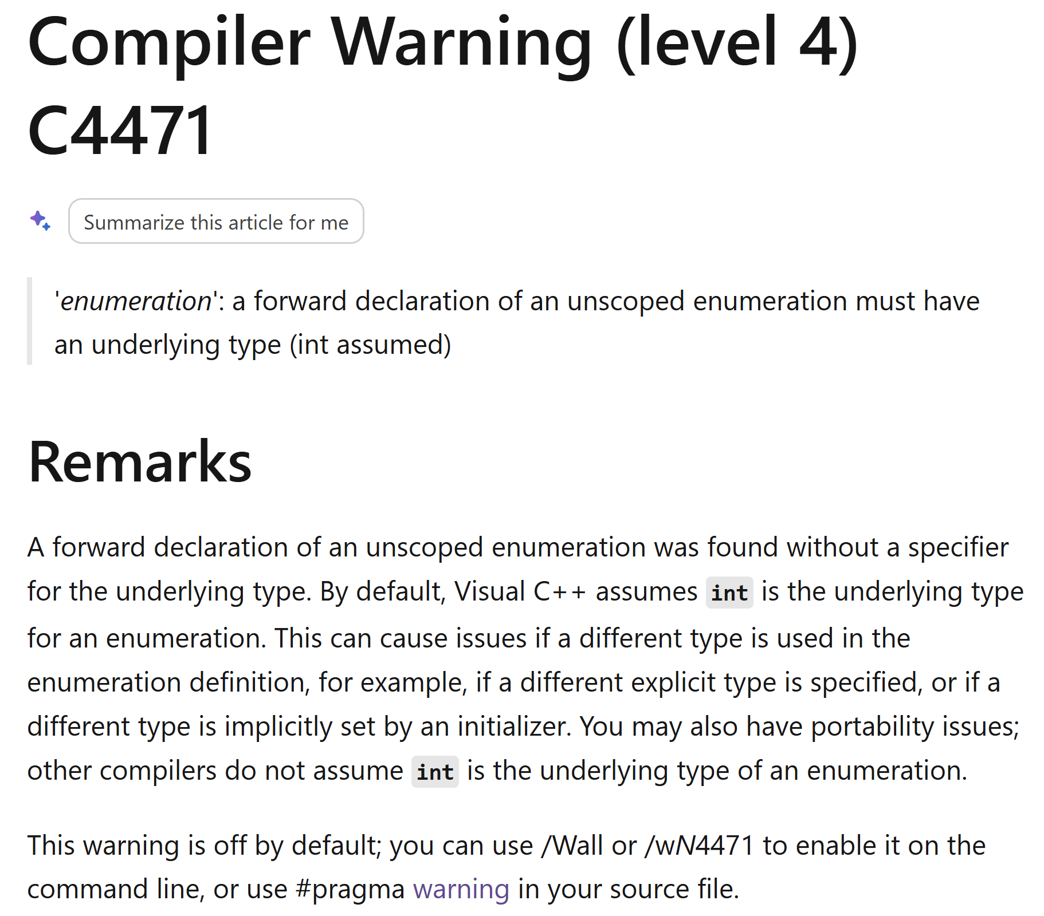

C4471
Notes:
Not that the bottom isn’t technically true. It is only off if you are compiling without /permissive-
If C++20 or permissive- is specified you will get this warning ☺

Slide 40
Code Review #2
enum MyEnum;
struct A
{
MyEnum mem;
};
enum MyEnum : char
{
One,
Two
};
int main()
{
return sizeof(A);
}

Slide 41
Code Review #2 – Potential Fix
enum MyEnum : char;
struct A
{
MyEnum mem;
};
enum MyEnum : char
{
One,
Two
};
int main()
{
return sizeof(A);
}

Slide 42
Code Review #2 – Actual Fix
#include “MyEnum.h"
struct A
{
MyEnum mem;
};
int main()
{
return sizeof(A);
}

Slide 43
Code Review #3
using TargetFuncSig = int(float, float);
using TargetFuncSigPtr = TargetFuncSig*;
int Foo(HMODULE InModule)
{
auto func = reinterpret_cast< TargetFuncSigPtr >(
GetProcAddress(InModule, “MyFunc")
);
return func(3.14f, 2.0f);
}

Slide 44
GetProcAddress
WINBASEAPI
FARPROC
WINAPI
GetProcAddress(
_In_ HMODULE hModule,
_In_ LPCSTR lpProcName
);
Notes:
22 mins

Slide 45
GetProcAddress
typedef INT_PTR (FAR WINAPI *FARPROC)();
WINBASEAPI
FARPROC
WINAPI
GetProcAddress(
_In_ HMODULE hModule,
_In_ LPCSTR lpProcName
);

Slide 46
GetProcAddress
typedef __int64 INT_PTR;
typedef INT_PTR (FAR WINAPI *FARPROC)();
WINBASEAPI
FARPROC
WINAPI
GetProcAddress(
_In_ HMODULE hModule,
_In_ LPCSTR lpProcName
);

Slide 47
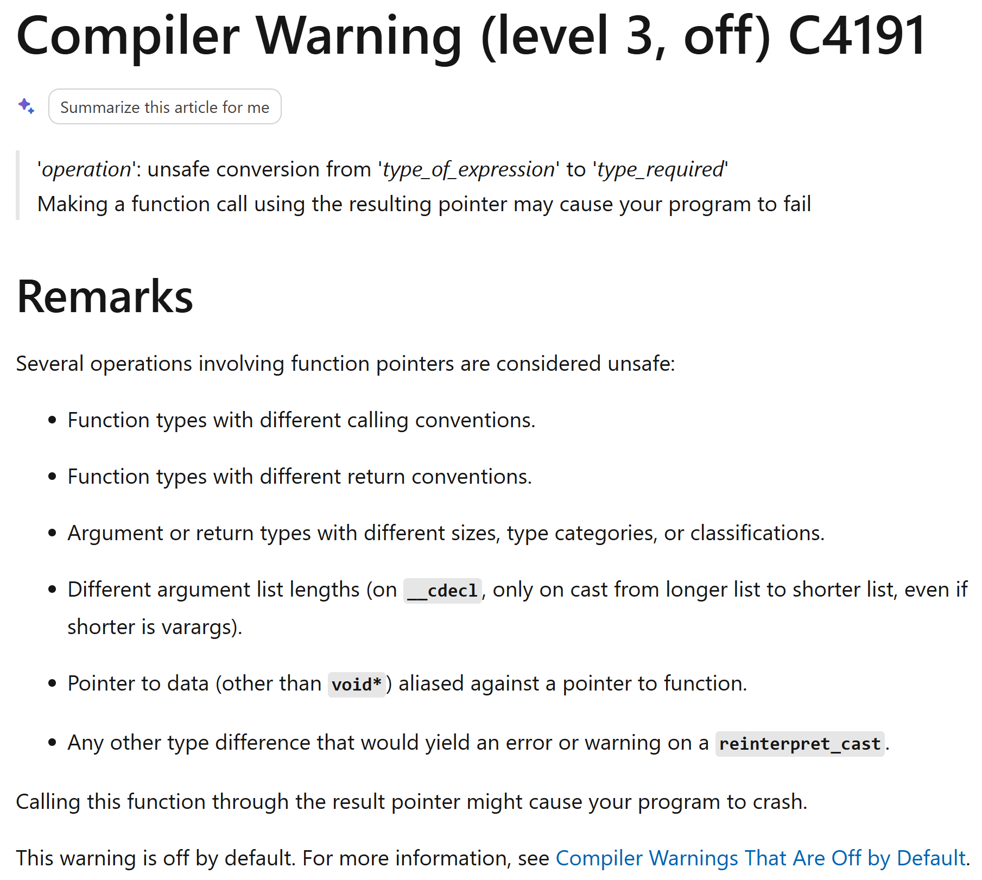

C4191

Slide 48
If we could have nice things…
WINBASEAPI
FARPROC
WINAPI
GetProcAddress(
_In_ HMODULE hModule,
_In_ LPCSTR lpProcName
);

Slide 49
If we could have nice things…
WINBASEAPI
void*
WINAPI
GetProcAddress(
_In_ HMODULE hModule,
_In_ LPCSTR lpProcName
);

Slide 50
Code Review #3 - Actual Fix
using TargetFuncSig = int(float, float);
using TargetFuncSigPtr = TargetFuncSig*;
int Foo(HMODULE InModule)
{
auto func = reinterpret_cast< TargetFuncSigPtr >(
GetProcAddress(InModule, “MyFunc")
);
return func(3.14f, 2.0f);
}

Slide 51
Code Review #3 - Actual Fix
using TargetFuncSig = int(float, float);
using TargetFuncSigPtr = TargetFuncSig*;
int Foo(HMODULE InModule)
{
#pragma warning( push )
#pragma warning(disable : 4191)
auto func = reinterpret_cast< TargetFuncSigPtr >(
GetProcAddress(InModule, “MyFunc")
);
#pragma warning(pop)
return func(3.14f, 2.0f);
}

Slide 52

… Are we done?
Build succeeded.
0 Warning(s)
0 Error(s)

Slide 53
Step 2?

Slide 54

On to the server then?

Slide 55
Code Review #4
void OnlineGameMode::EndSession()
{
UnregisterEvents();
if (GetRole() != NM_DedicatedServer)
{
return;
}
TelemetryInterface.EndSession();
}

Slide 56
Code Review #4
enum ENetMode
{
NM_Standalone,
NM_DedicatedServer,
NM_ListenServer,
NM_Client,
NM_MAX,
};
void OnlineGameMode::EndSession()
{
UnregisterEvents();
if (GetRole() != NM_DedicatedServer)
{
return;
}
TelemetryInterface.EndSession();
}
enum ENetRole
{
ROLE_None,
ROLE_SimulatedProxy,
ROLE_AutonomousProxy,
ROLE_Authority,
ROLE_MAX,
};

Slide 57
Code Review #4
enum ENetMode
{
NM_Standalone,
NM_DedicatedServer,
NM_ListenServer,
NM_Client,
NM_MAX,
};
void OnlineGameMode::EndSession()
{
UnregisterEvents();
if (ROLE_Authority != NM_DedicatedServer)
{
return;
}
TelemetryInterface.EndSession();
}
enum ENetRole
{
ROLE_None,
ROLE_SimulatedProxy,
ROLE_AutonomousProxy,
ROLE_Authority,
ROLE_MAX,
};

Slide 58
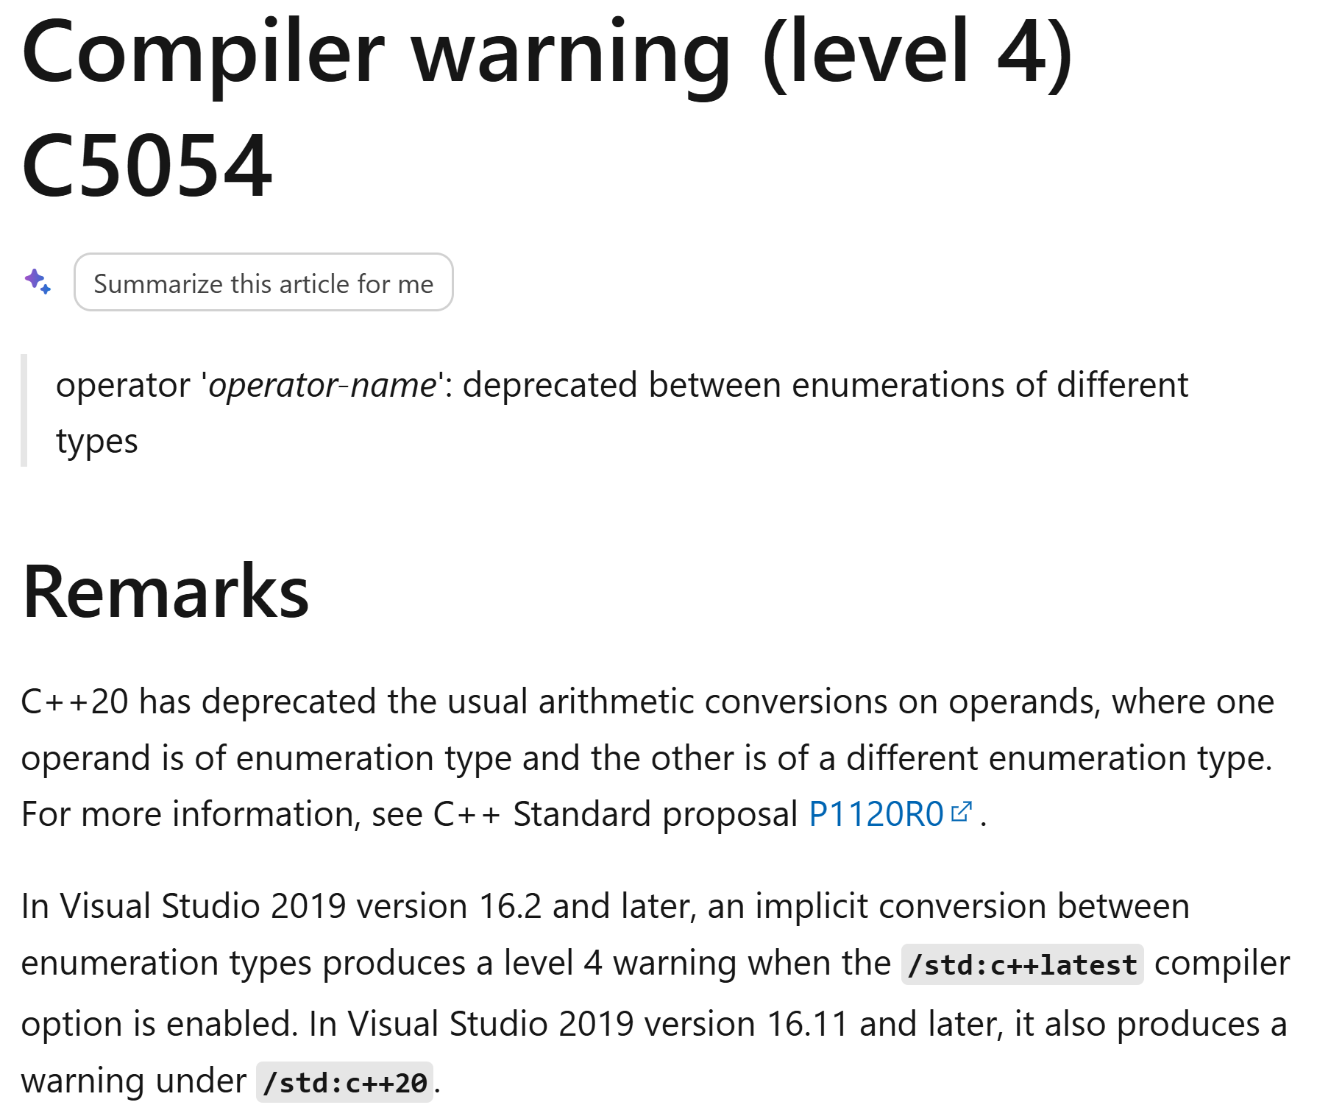

C5054 / -Wdeprecated-enum-compare

Slide 59
Code Review #4 - Fix
void OnlineGameMode::EndSession()
{
UnregisterEvents();
if (GetRole() != NM_DedicatedServer)
{
return;
}
TelemetryInterface.EndSession();
}

Slide 60
Code Review #4 - Fix
void OnlineGameMode::EndSession()
{
UnregisterEvents();
TelemetryInterface.EndSession();
}

Slide 61
… Are we done?
Build succeeded.
0 Warning(s)
0 Error(s)

Slide 62
Add /WX for Server

Slide 63

Are we really at /W4 /WX for Editor and Server?

Slide 64
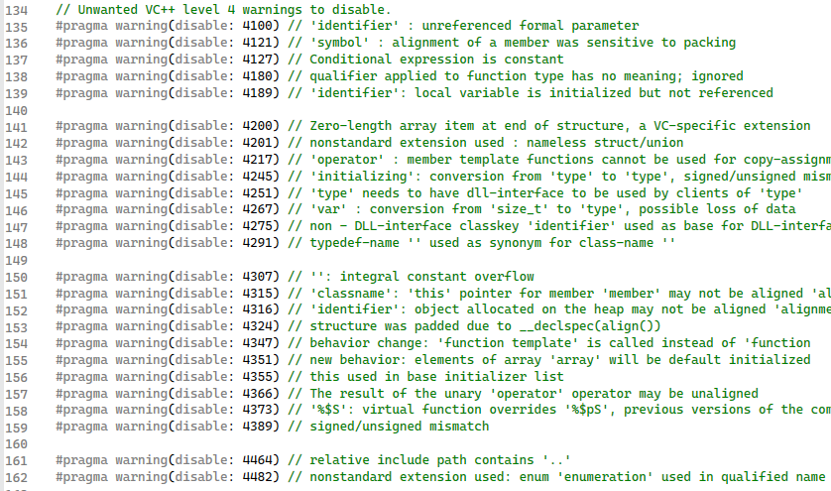
Enter WindowsPlatformCompilerSetup.h

Slide 65
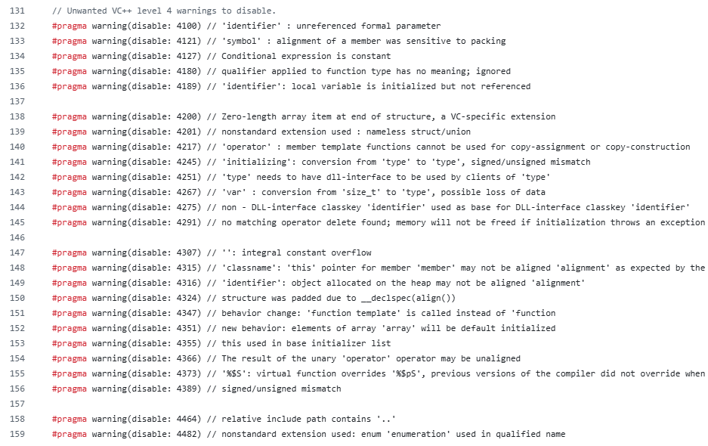

Compare with latest Unreal Engine

Slide 66




This affects every Unreal Engine game

Slide 67

What about the response files?
/wd4463
/wd4838
/wd4458
/wd4456
/wd4459
/wd4819

Slide 68

New Plan!

Slide 69
New Plan!
editor.Disable(warningsAsErrors);
for (auto& warning : disabledWarnings)
{
warning.Enable();
const auto buildResult = editor.Build();
if (buildResult.Success())
  {
  pendingWarningsToEnable.Add(warning);
  }
}

Slide 70
New Plan!
editor.Disable(warningsAsErrors);
for (auto& warning : disabledWarnings)
{
else
  {
  if (ShouldFix(warning, buildResult))
  {
  Fix(warning);
  pendingWarningsToEnable.Add(warning);
  }
  else
  {
  warning.disable();
  }
  }
}
editor.Enable(warningsAsErrors);

Slide 71
Heuristics for ShouldFix()
Probably should fix
Probably not worth it

Slide 72
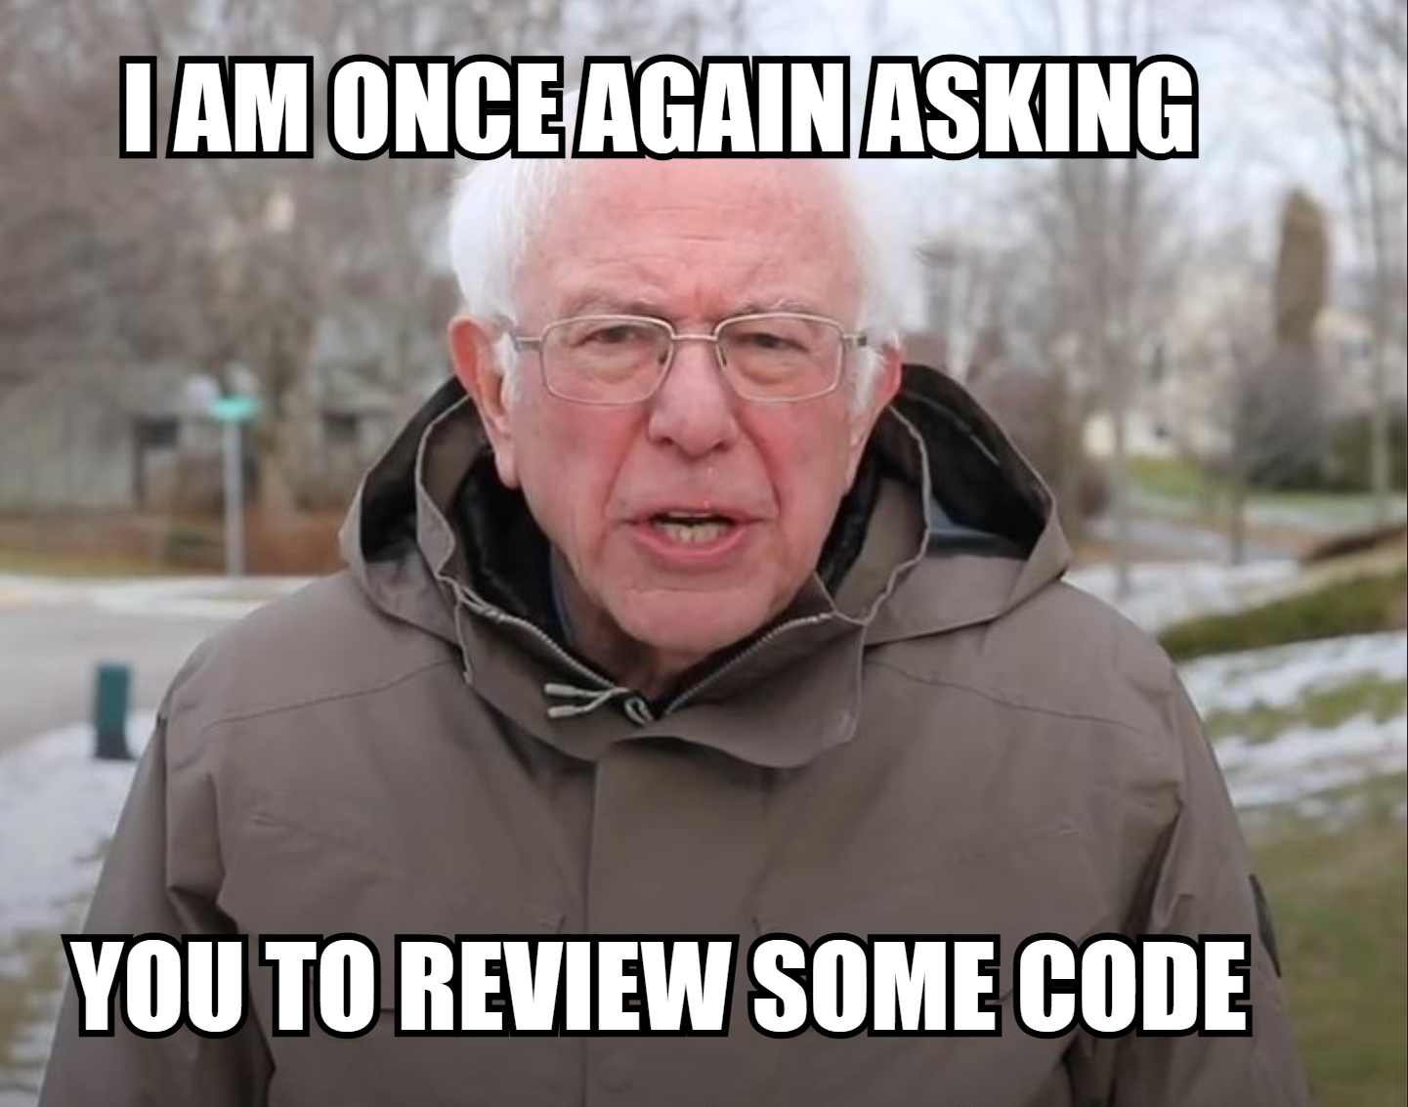

Slide 73
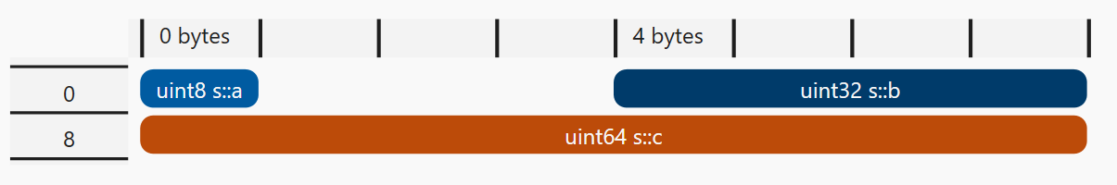
Code Review #5
struct MyStruct
{
uint8 a = 0;
uint32 b = 0;
uint64 c = 0;
};

Slide 74
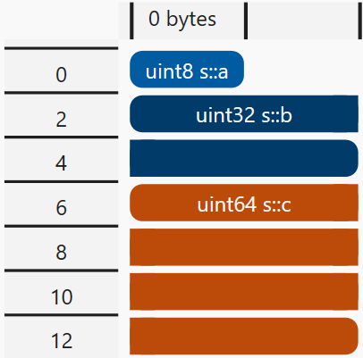
Code Review #5
#pragma pack(2)
struct MyStruct
{
uint8 a = 0;
uint32 b = 0;
uint64 c = 0;
};

Slide 75
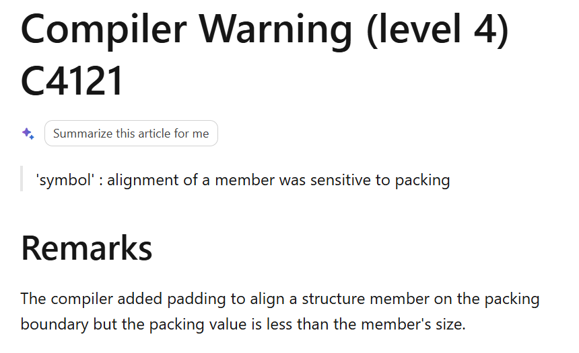

C4121

Slide 76
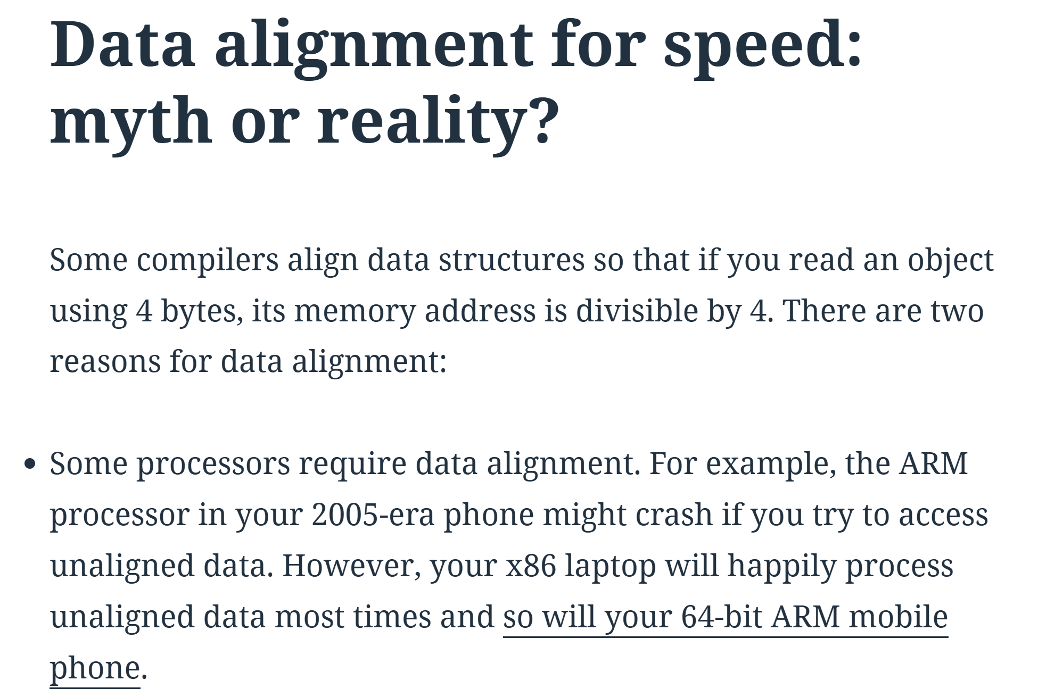

How much of a problem is this really?
Notes:
Daniel Lemire
From 2012!
Long series of comments and rebuttals.
Last comment was from last year
It would seem that in the world of x86/x64 and ARM, unaligned accesses are not something to worry about, performance-wise

Slide 77
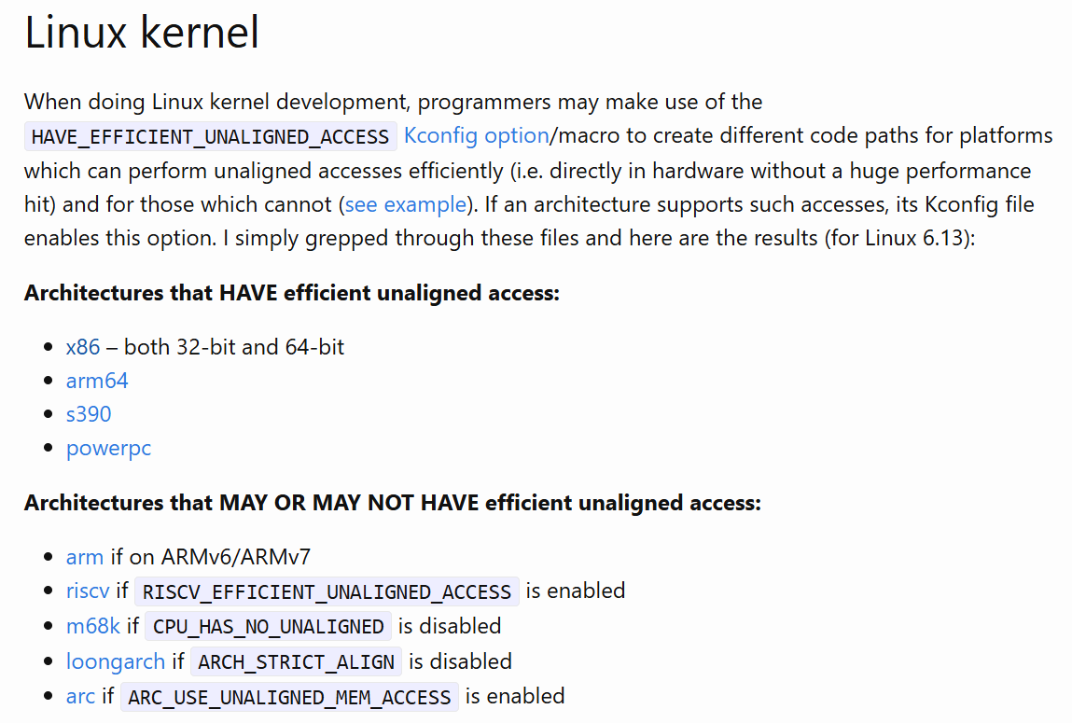

How much of a problem is this really?
Notes:
Linux kernel developers would agree with this.

Slide 78
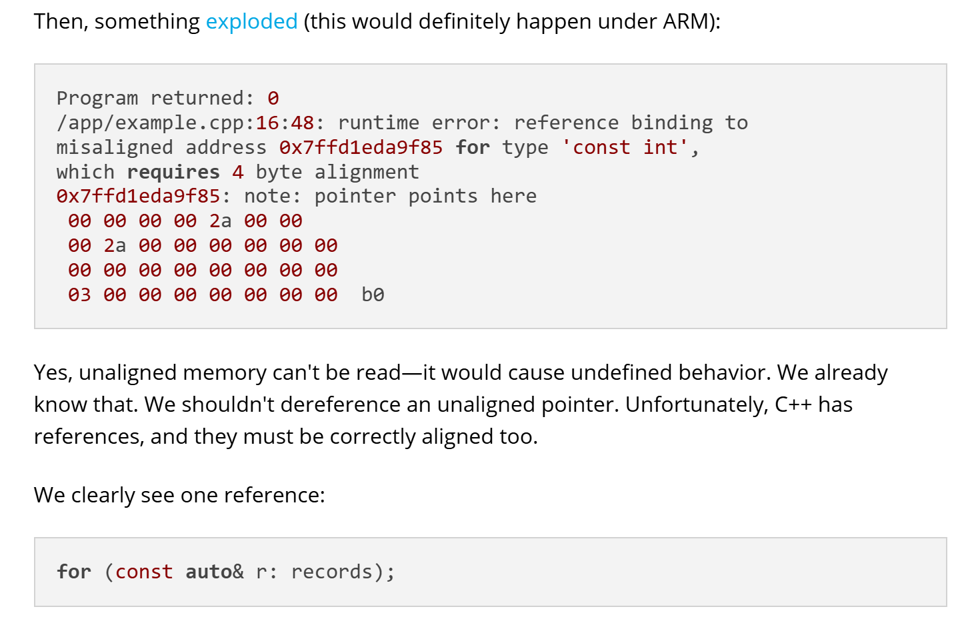

How much of a problem is this really?
Notes:
But the folks at PVS Studio are quick to point out that unaligned accesses are UB!

Slide 79
Should we fix C4121?
C4121

Slide 80
Code Review #6
// CoreLib.cpp
static void DoSomethingHelper()
{
// Many lines of complicated code.
}
void CoreLib::DoSomething()
{
DoSomethingHelper();
// Some more stuff
}

Slide 81
Code Review #6
// CoreLib.cpp
static void DoSomethingHelper()
{
// Many lines of complicated code.
}
void CoreLib::DoSomething()
{
// Some more stuff
}

Slide 82
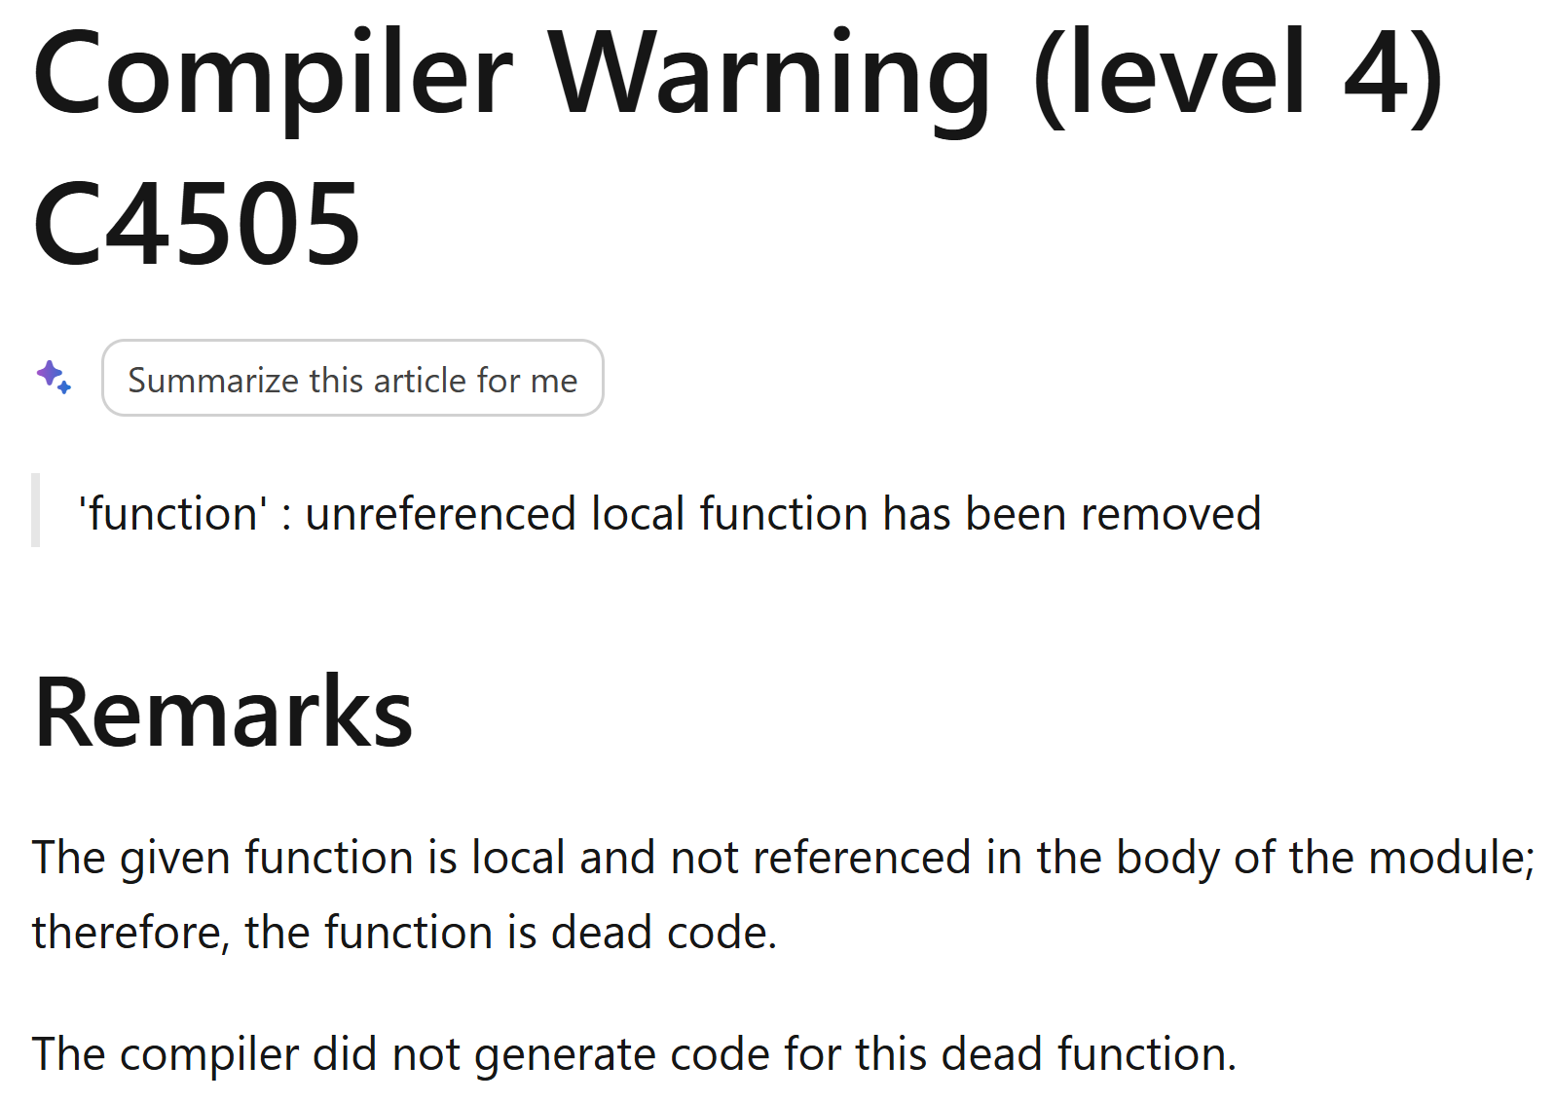

C4505 / -Wunused-function
Notes:
This comes with -Wall

Slide 83
Code Review #6
// CoreLib.cpp
static void DoSomethingHelper()
{
// Many lines of complicated code.
}
void CoreLib::DoSomething()
{
DoSomethingHelper();
// Some more stuff
}

Slide 84
Code Review #6 - Fix
// CoreLib.cpp
void CoreLib::DoSomething()
{
// Some more stuff
}

Slide 85
Code Review #6.1
// CoreLib.h
static void DoSomethingHelper()
{
// Many lines of complicated code.
}

Slide 86
Code Review #6.1 - Fix
// CoreLib.h
inline void DoSomethingHelper()
{
// Many lines of complicated code.
}

Slide 87
Should we fix C4505?
C4505

Slide 88
Any binary size savings?
1KB!

Slide 89
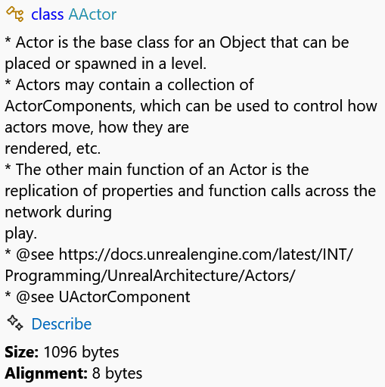
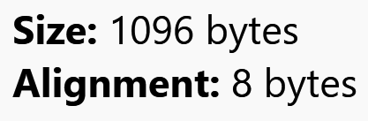
Not really…
1KB!

Slide 90
Not really…
1KB!

Slide 91
Code Review #7
class A
{
public:
~A();
virtual void DoSomething();
};

Slide 92
Code Review #7 - Fix
class A
{
public:
virtual ~A();
virtual void DoSomething();
};

Slide 93
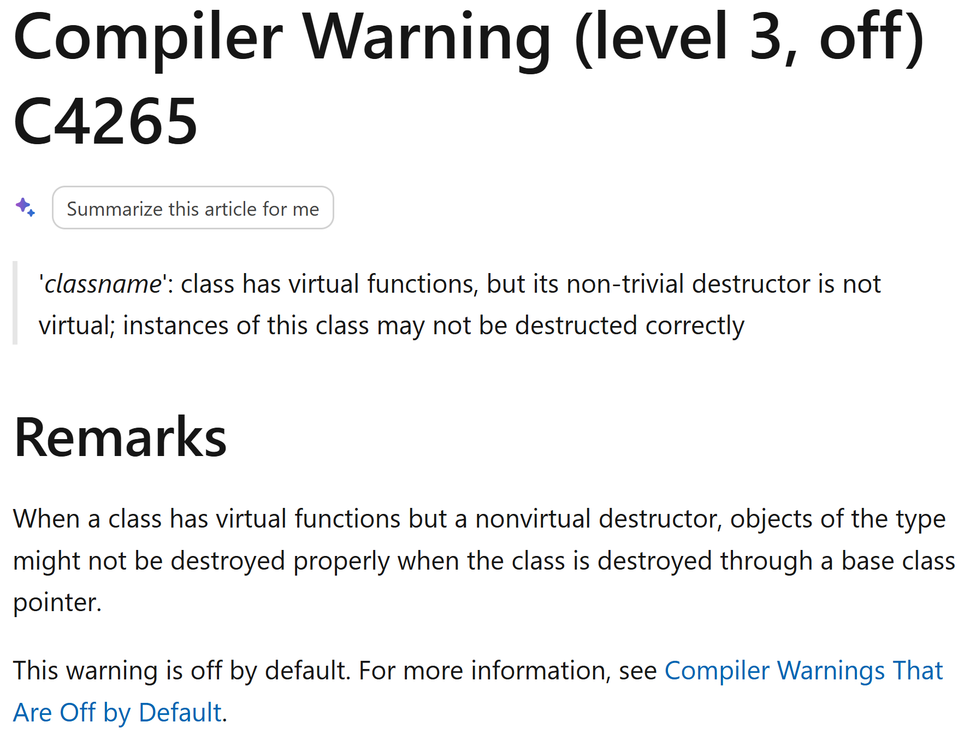

C4265/-Wdelete-non-virtual-dtor
Notes:
Off by default. Current Unreal Engine has this enabled.
Clang and GCC are a bit better with this warning. They only warn on it at the point of deletion
However, GCC won’t actually warn if you are using a unique ptr.

Slide 94
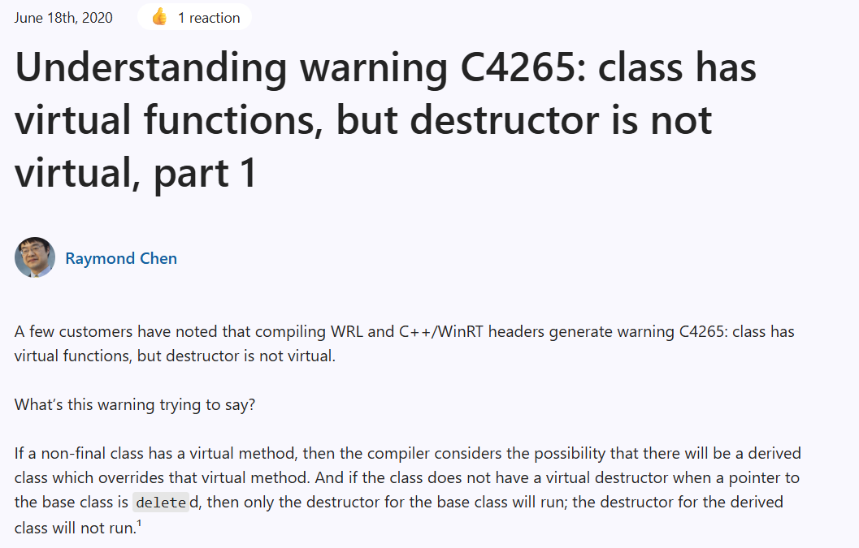

Old New Thing on C4265
Notes:
Raymond notes that it would probably be better if this warning had the same behaviour as Clang

Slide 95
How much of an issue is this?
struct A
{
~A() = default;
};
struct B : A
{
~B()
{
std::puts("Hello BeCPP!");
}
};
A* GetRaw()
{
return new B;
}
int main()
{
auto result = GetRaw();
delete result;
}

Slide 96
How much of an issue is this?
struct A
{
~A() = default;
};
struct B : A
{
~B()
{
std::puts("Hello BeCPP!");
}
};
std::unique_ptr<A> GetUnique()
{
return std::make_unique<B>();
}
int main()
{
auto result = GetUnique();
}

Slide 97
How much of an issue is this?
struct A
{
~A() = default;
};
struct B : A
{
~B()
{
std::puts("Hello BeCPP!");
}
};
std::shared_ptr<A> GetShared()
{
return std::make_shared<B>();
}
int main()
{
auto result = GetShared();
}

Slide 98
Should we fix C4265?
C4265
Notes:
253 unique hits
About 7560 warnings reported initially
We probably should fix it. If we can see that a virtual interface has a virtual destructor, we do not have to reason about whether all uses of the class are correct
Local reasoning

Slide 99
Code Review #8
struct A
{
uint32 Field = 0;
};
int32 Do(const A& InA, const int32 Test)
{
if (InA.Field != Test)
{
return 1;
}
return 0;
}

Slide 100
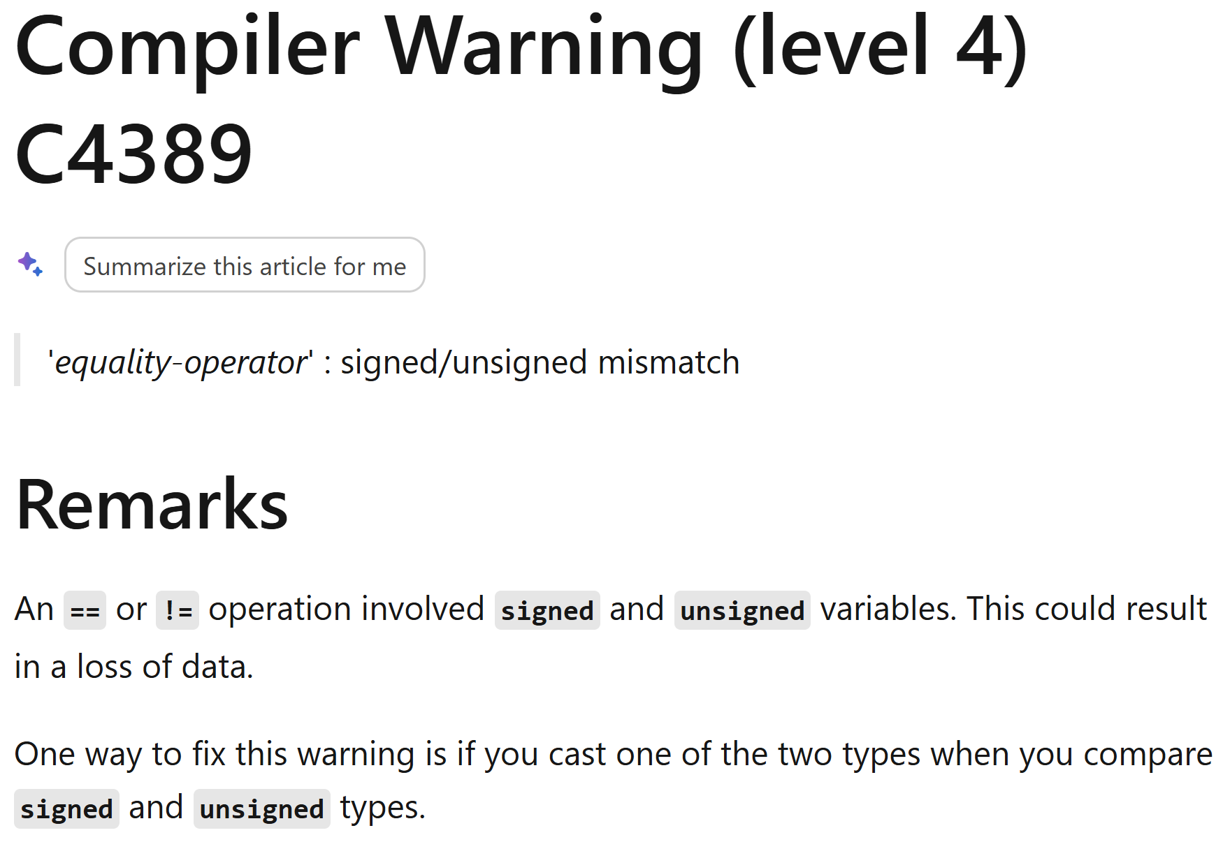

C4389 / Wsign-compare

Slide 101
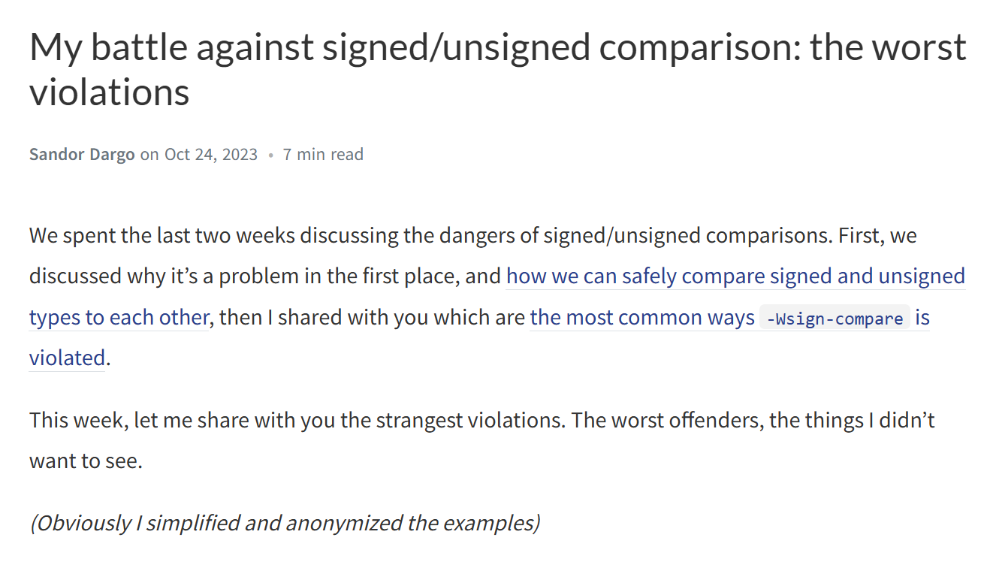

Well-known good practice

Slide 102
Should we fix C4389?
C4389
Notes:
414 unique hits
About 606 warnings reported initially

Slide 103
Code Review #8.1
struct A
{
uint32 Field = 0;
};
int32 Do(const A& InA, const int32 Test)
{
if (InA.Field != Test)
{
return 1;
}
return 0;
}

Slide 104
Code Review #8.1
struct A
{
uint32 Field : 1 = false;
};
int32 Do(const A& InA, const bool Test)
{
if (InA.Field != Test)
{
return 1;
}
return 0;
}

Slide 105
Code Review #8.1
struct A
{
uint32 Field : 1 = false;
};
int32 Do(const A& InA)
{
if (InA.Field != false)
{
return 1;
}
return 0;
}

Slide 106
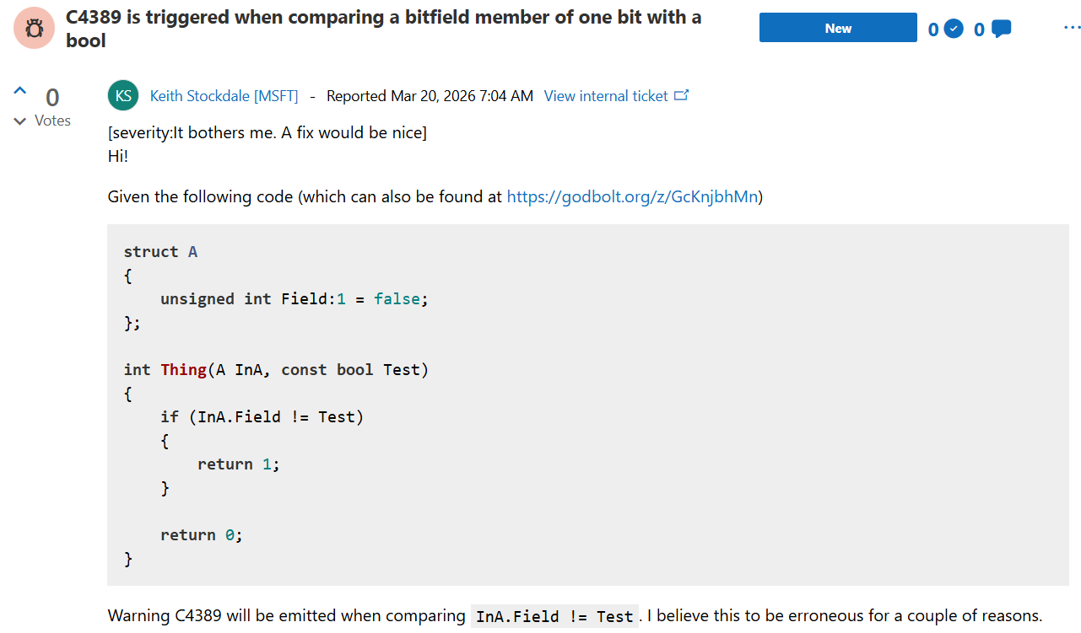

See a bug, report a bug

Slide 107
Should we fix C4389?
C4389
Notes:
414 unique hits
About 606 warnings reported initially

Slide 108
Should we fix C4389?
C4389
Notes:
Probably not!

Slide 109
Code Review #9
const FHlslToken* FHlslScanner::GetCurrentTokenAndAdvance()
{
if (CurrentToken < Tokens.Num())
{
auto* Return = &Tokens[CurrentToken];
Advance();
}
return nullptr;
}

Slide 110
Code Review #9 - Fix
const FHlslToken* FHlslScanner::GetCurrentTokenAndAdvance()
{
if (CurrentToken < Tokens.Num())
{
auto* Return = &Tokens[CurrentToken];
Advance();
return Return;
}
return nullptr;
}

Slide 111
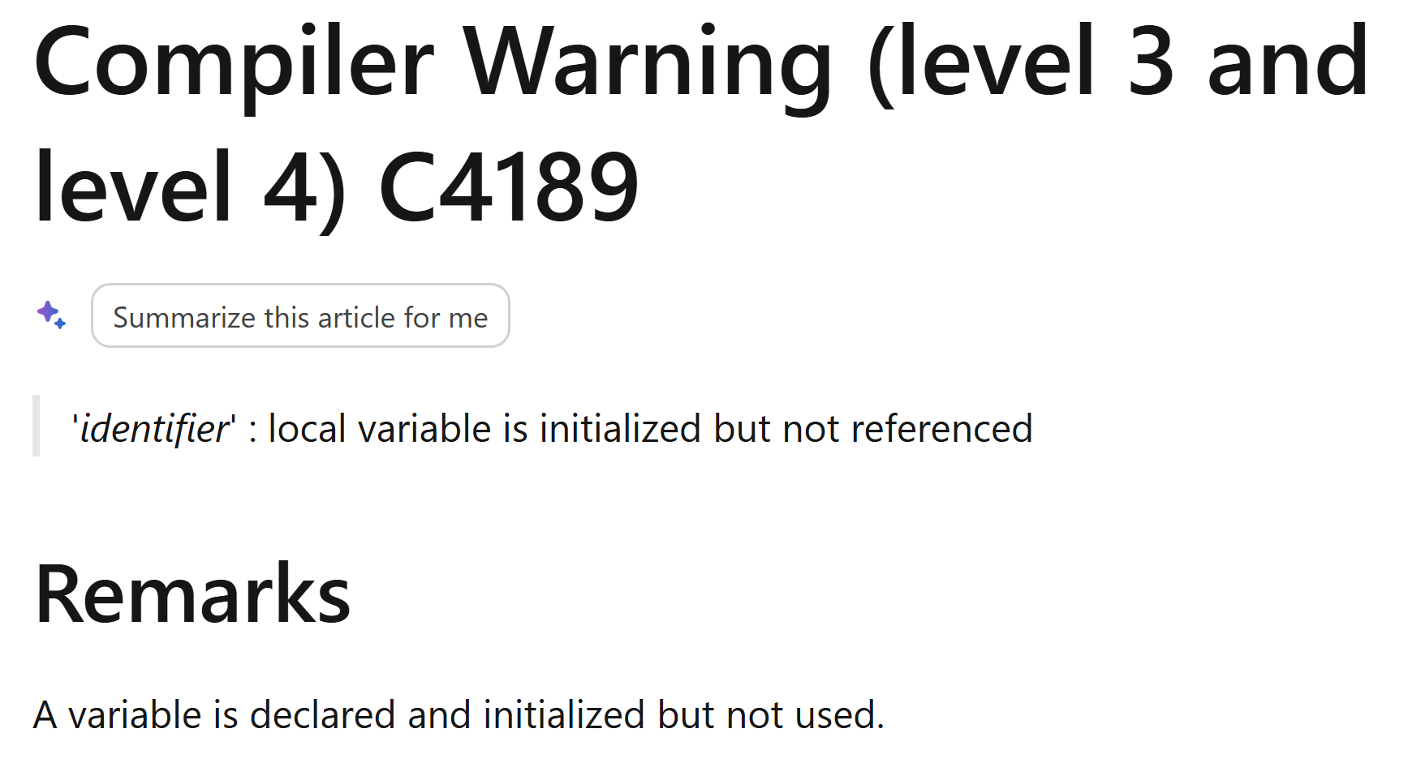

C4189 / -Wunused-variable

Slide 112
Code Review #9.1
struct FAllocTask
{
static void Alloc()
{
int* IntAlloc = new int[1000];
int8* LeakTask = new int8[100000];
SAFEDELETEARRAY( IntAlloc);
}
};

Slide 113
Code Review #9.2
template<class TClassA>
FORCEINLINE TSubclassOf(const TSubclassOf<TClassA>& From) :
Class(*From)
{
// verify that TClassA derives from TClass
TClass* Test = (TClassA*)0;
}

Slide 114
Code Review #9.2
template<class TClassA>
FORCEINLINE TSubclassOf(const TSubclassOf<TClassA>& From) :
Class(*From)
{
// verify that TClassA derives from TClass
static_assert(std::is_base_of_v<TClass, TClassA>);
}
Notes:
Clearly written before we had static assert or type traits or something like that

Slide 115
Code Review #9.2
template<class TClassA>
requires std::derived_from<TClassA, TClass>
FORCEINLINE TSubclassOf(const TSubclassOf<TClassA>& From) :
Class(*From)
{
}
Notes:
Clearly written before we had static assert or type traits or something like that

Slide 116
Code Review #9.3
UMockWieldableComponent* MockWieldable = CreateMockWieldable();
TestNotNullOrAbort(
  TEXT("Expected a valid MockWieldable to have been created")
  );
Notes:
Clearly TestNotNullOrAbort is easy to use incorrectly

Slide 117
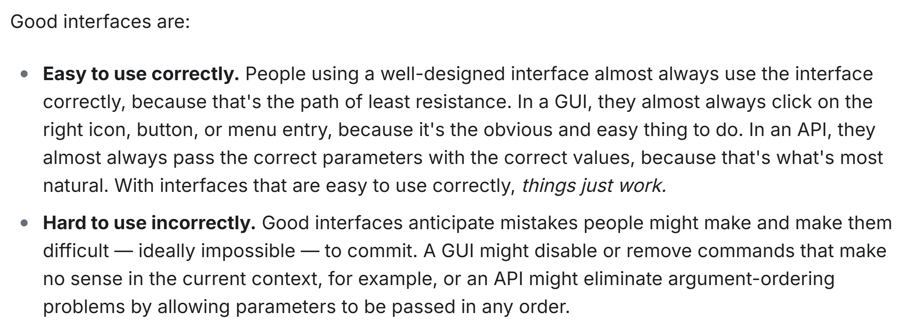

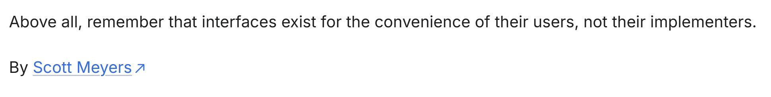
Breaking rule 55 here…
Notes:
From 97 things ever programmer should know

Slide 118
Code Review #9.3
template<typename PointerType>
void TestNotNullOrAbort(const PointerType* Pointer)
{
TestNotNullOrAbort(FString(), Pointer);
}
template<typename PointerType>
void TestNotNullOrAbort(const FString& Message, const PointerType* Pointer)
{
if (!Pointer)
{
throw AssertionException(
FString::Printf(TEXT("%s: Given value was null."), *Message)
);
}
}
Notes:
Clearly TestNotNullOrAbort is easy to use incorrectly

Slide 119
Code Review #9.3
template<typename PointerType>
requires (!TIsCharType<PointerType>::Value)
void TestNotNullOrAbort(const PointerType* Pointer)
{
TestNotNullOrAbort(FString(), Pointer);
}
template<typename PointerType>
void TestNotNullOrAbort(const FString& Message, const PointerType* Pointer)
{
if (!Pointer)
{
throw AssertionException(
FString::Printf(TEXT("%s: Given value was null."), *Message)
);
}
}
Notes:
Clearly TestNotNullOrAbort is easy to use incorrectly

Slide 120
Code Review #9.4
void DoSomething()
{
auto result
= ExpensiveFunctionWithNoSideEffects();
// Never use result :)
}
Notes:
Clearly TestNotNullOrAbort is easy to use incorrectly

Slide 121
Code Review #9.4
void DoSomething()
{
// Much quicker ;)
}
Notes:
Clearly TestNotNullOrAbort is easy to use incorrectly

Slide 122
Should we fix C4189?
C4189
Notes:
9525 unique hits
About 17000 warnings reported initially

Slide 123
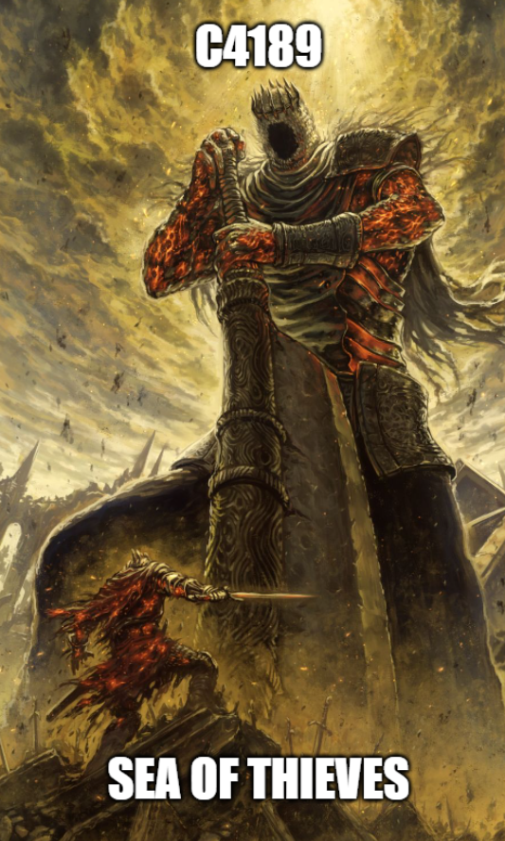
C4189 is the final boss
Notes:
16698 hits.
But damn useful

Slide 124
Current Progress on C4189
Status | Number of Unique Warnings
Started | 9525
Currently Have | 4977

Slide 125
Wrapping Up

Slide 126
So how hard is it?
Deliverable
Number of diffs
Number of Reviewed CLs
/WX (Editor)
105
9
/WX (Server)
2
2
Enable C4121
2
1
Enable C4505
280
11
Enable C4265
254
18
Enable C4373
2
1
Enable C4180
11
2
Enable C4091
28
4

Slide 127
Warnings are USEFUL…
They find bugs
They find unnecessary code
They find performance issues
They make code reviews easier

Slide 128
… but…
Some can be more hassle than they are worth
Usefulness is usually proportional to the number of issues
Number of issues is likely related to the size of your project

Slide 129
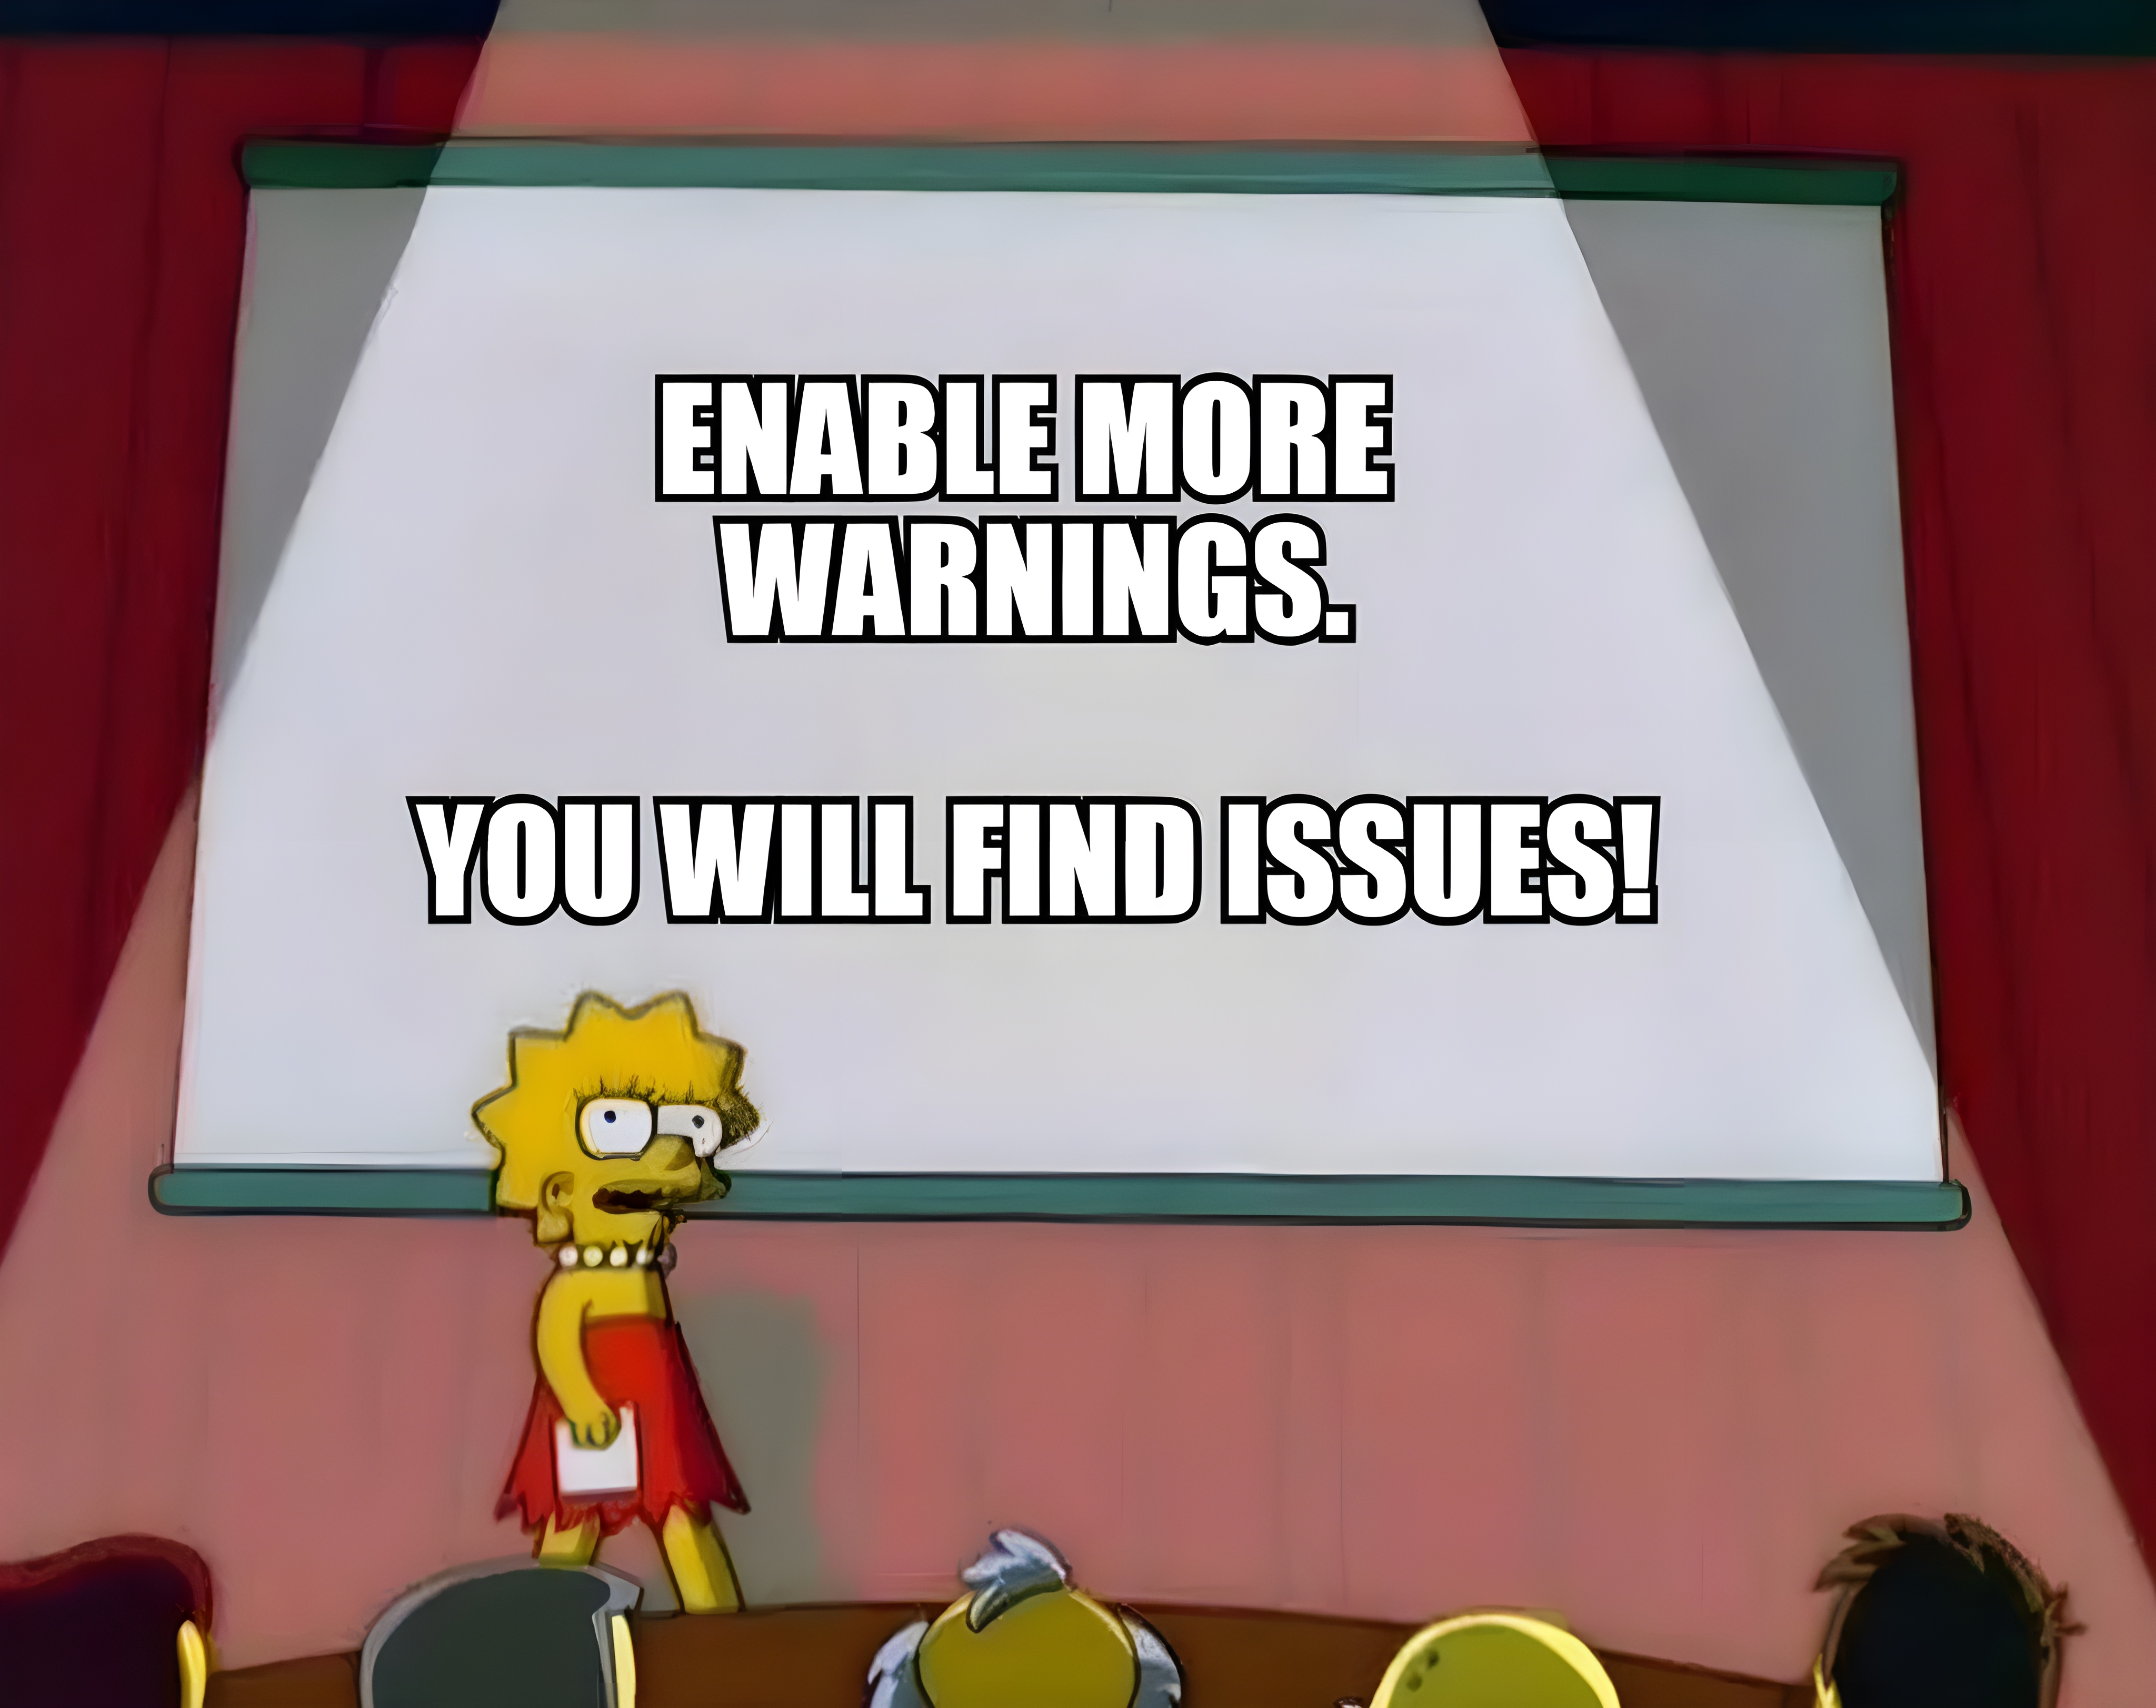
A call to action

Slide 130
Q&A

